Slide 1
AQA Additional Biology part 2 use this in conjunction with your revision guide

Slide 2
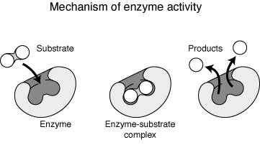
Enzymes
Substances in plants and animals that speed biochemical reactions are called enzymes. Enzymes can build up or break down other molecules. The molecules they act on are called substrates. Enzymes are catalysts—chemicals that hasten a chemical reaction without undergoing any change themselves.

Slide 3
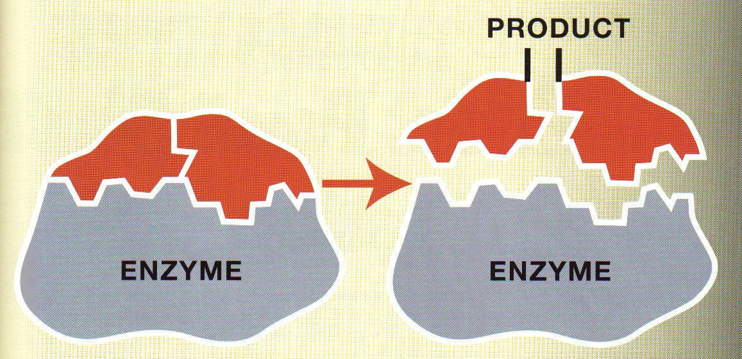
Enzymes

Slide 4
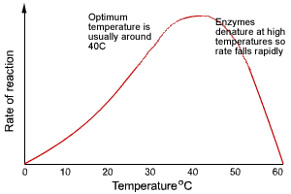
Enzymes and temperature

Slide 5
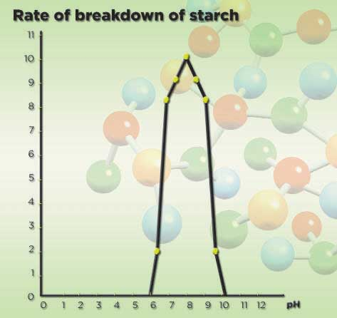
Enzymes and pH

Slide 6
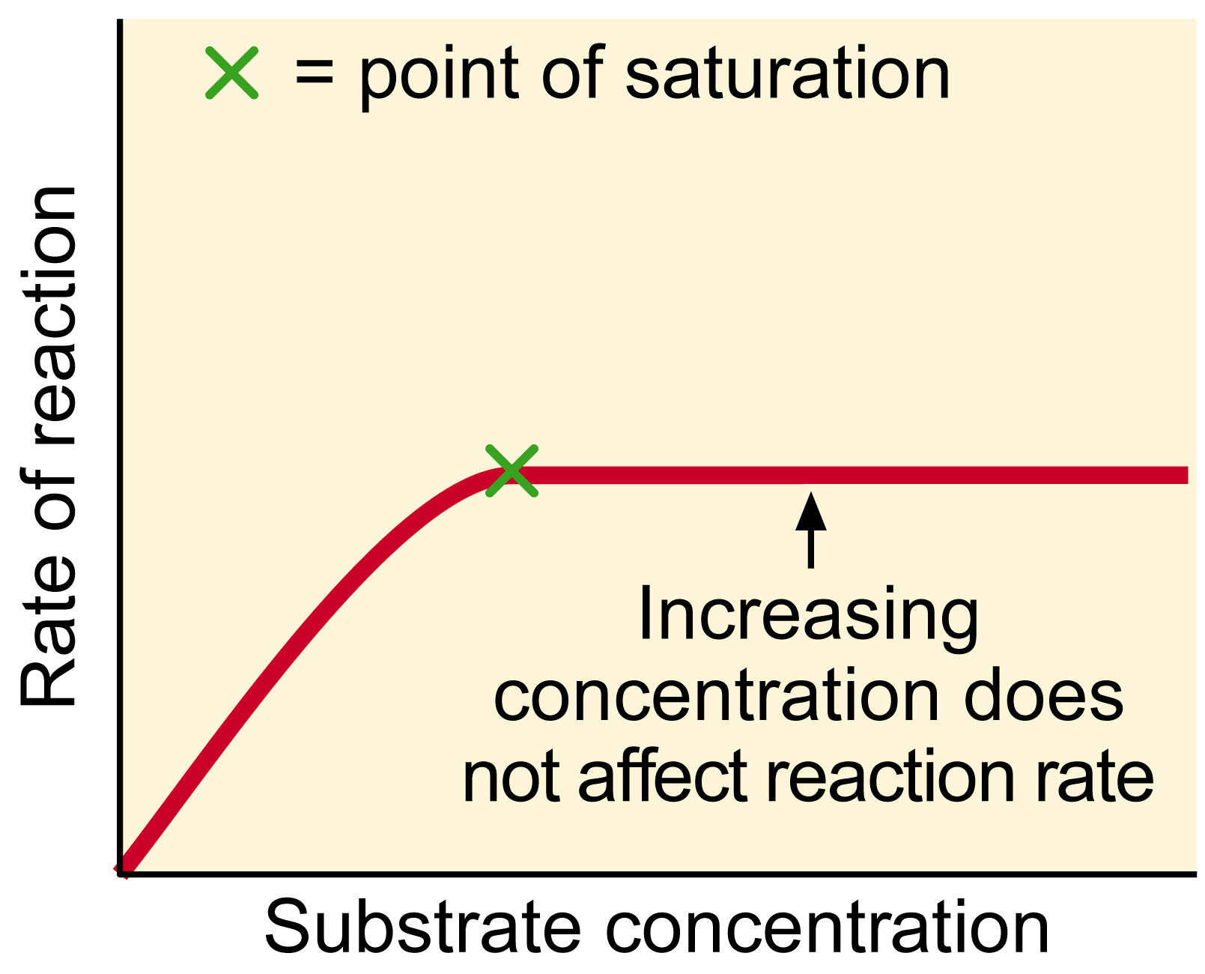

Slide 7
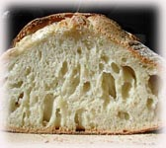
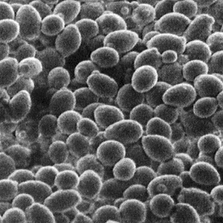
Bakers yeast use enzymes

Slide 8
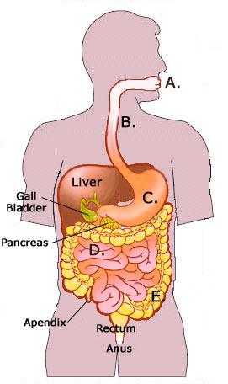
Digestive system

Slide 9
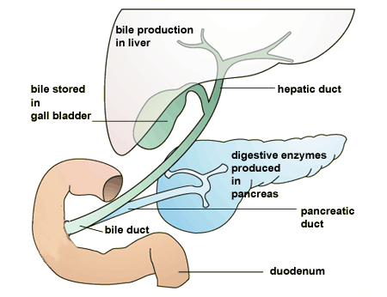
Digestive enzymes and bile

Slide 10
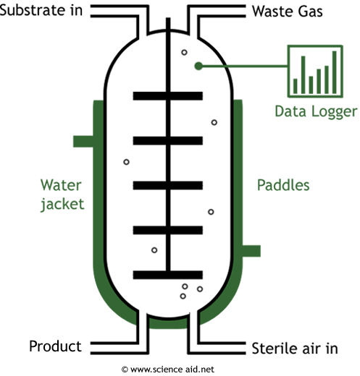
enzymes in industry

Slide 11
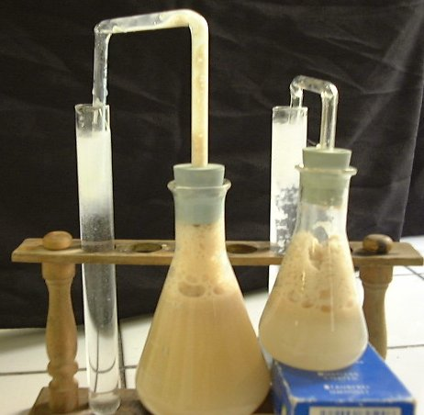
Fermentation

Slide 12
Fermentation
Fermentation is when a cell uses sugar for energy without using oxygen at the same time. Yeast is an organism that ferments. When yeast ferments sugar, the yeast eats sugar and makes alcohol. Other cells make vinegar or lactic acid when they ferment sugar.
When yeast ferments, it breaks down the glucose (C₆H₁₂O₆) into ethanol (CH₃CH₂OH) and carbon dioxide (CO₂).
Ethanol fermentation always produces ethanol and carbon dioxide. It is important in bread-making, brewing, and wine-making.
Lactic acid fermentation produces lactic acid. It happens in muscles of animals when they need lots of energy fast.

Slide 13
Homeostasis
Homeostasis (homeo meaning "same" and stasis meaning "condition") is when an organism keeps its bodily conditions (pH, temperature, amount of oxygen or carbon dioxide in the blood, for example) in a stable condition. It does so by regulating its inner equilibrium. In living things, the study of how they keep in a stable condition if called physiology.
Examples of homeostasis:
The regulation of water and minerals in the body.
The regulation of body temperature. This is done by sweating to cool off and shivering to warm up.
In mammals, the main organs involved with homeostasis are:
The hypothalamus and pituitary gland
the lungs
the skin
the muscles
the kidneys
the liver and pancreas

Slide 14
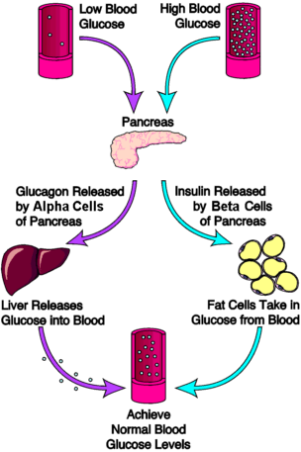
Homeostasis

Slide 15
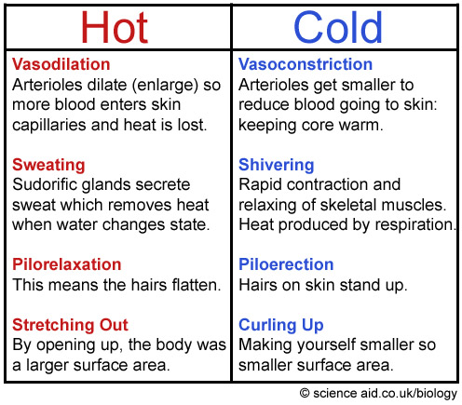
Temperature

Slide 16
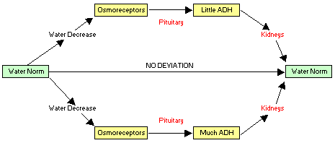
Homeostasis water balance

Slide 17
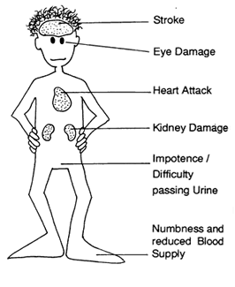
Diabetes

Slide 18
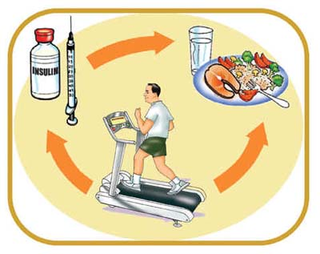
Insulin

Slide 19
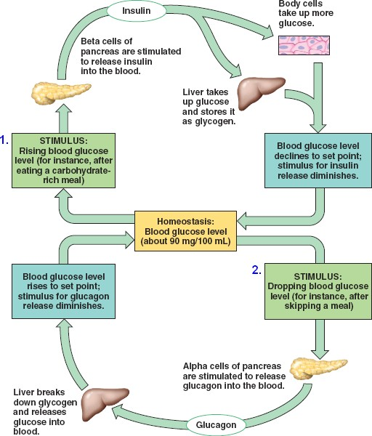
Glucose - homeostasis

Slide 20
Mini test
Put these in order
Chromosomes
Genome
Gene
DNA
Add their meaning
Unit of information
Collection of information units
All of the information units for an organism
The code for the information

Slide 21
Method of Inheritance
Alphabet (a,b,c,d,e,..)
Sentence (You will be able to roll your tongue.)
Chapter of a book (full of sentences)
Book (all the sentences – all the chapters)
DNA (building blocks)
Gene
(unit of information)
Chromosome (a stack of genes)
Genome (all the genes – all the chromosomes)

Slide 22
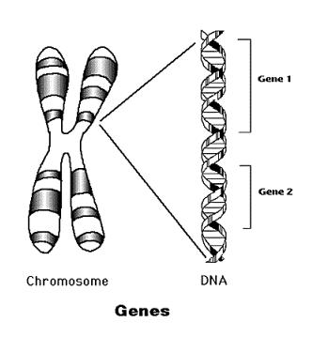
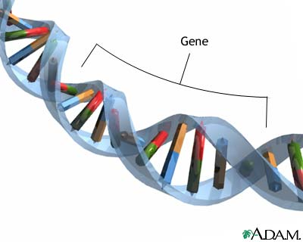
Gene

Slide 23
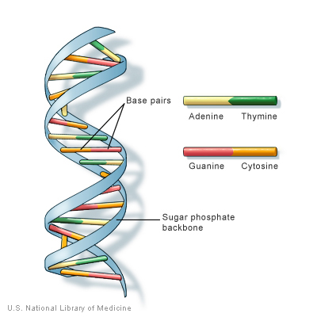
DNA

Slide 24
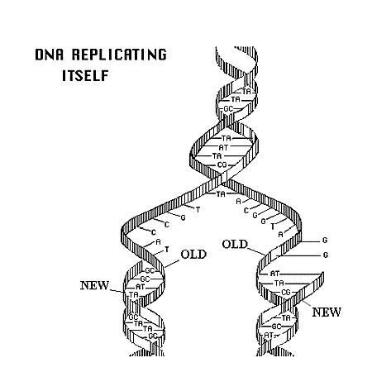
DNA

Slide 25
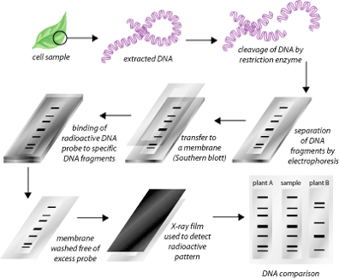

Slide 26
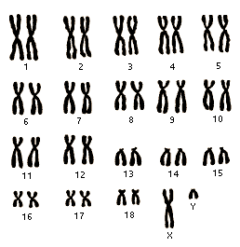
Chromosomes

Slide 27
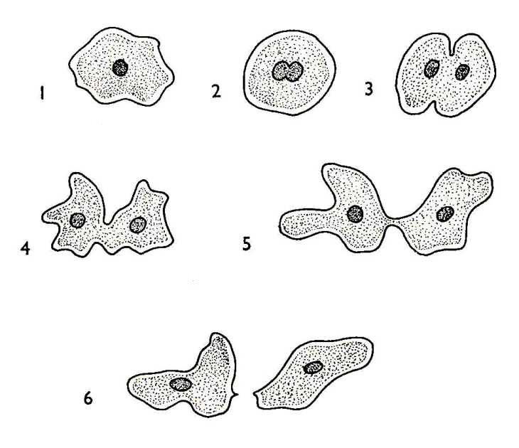
Asexual reproduction

Slide 28
Mitosis
Google
Mitosis animation – mitosis on the run

Slide 29
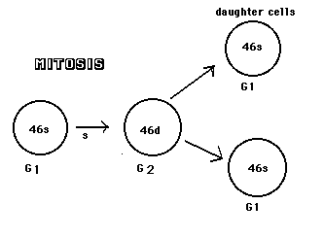

Slide 30
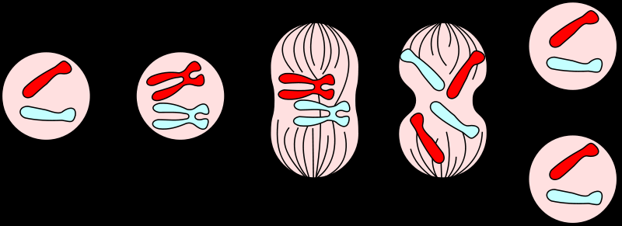
Mitosis – chromosomes replicate then cell divides
DNA Replication
Mitosis
2 Daughter cells

Slide 31
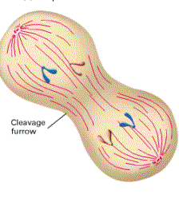
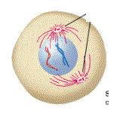
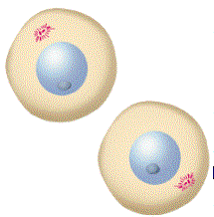
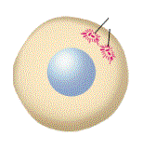
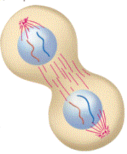
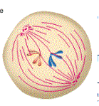
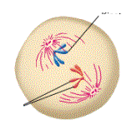
B
C
A
E
G
Put them in the right order
D
F

Slide 32
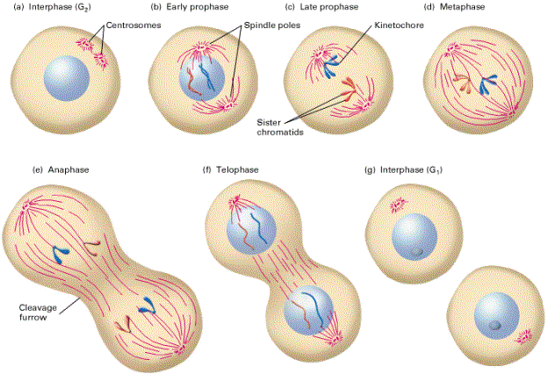

Slide 33
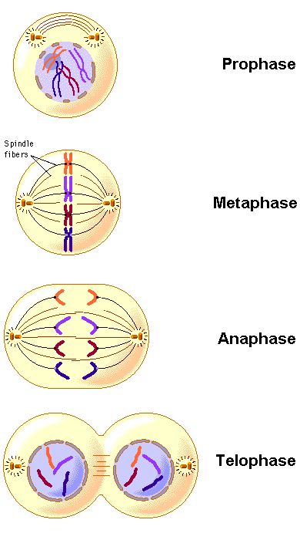
Inheritance mitosis

Slide 34
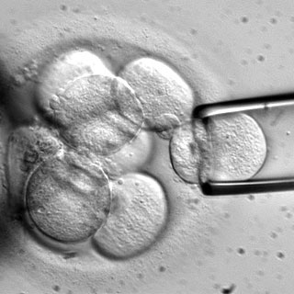
Stem Cells
Harvesting a stem cell

Slide 35
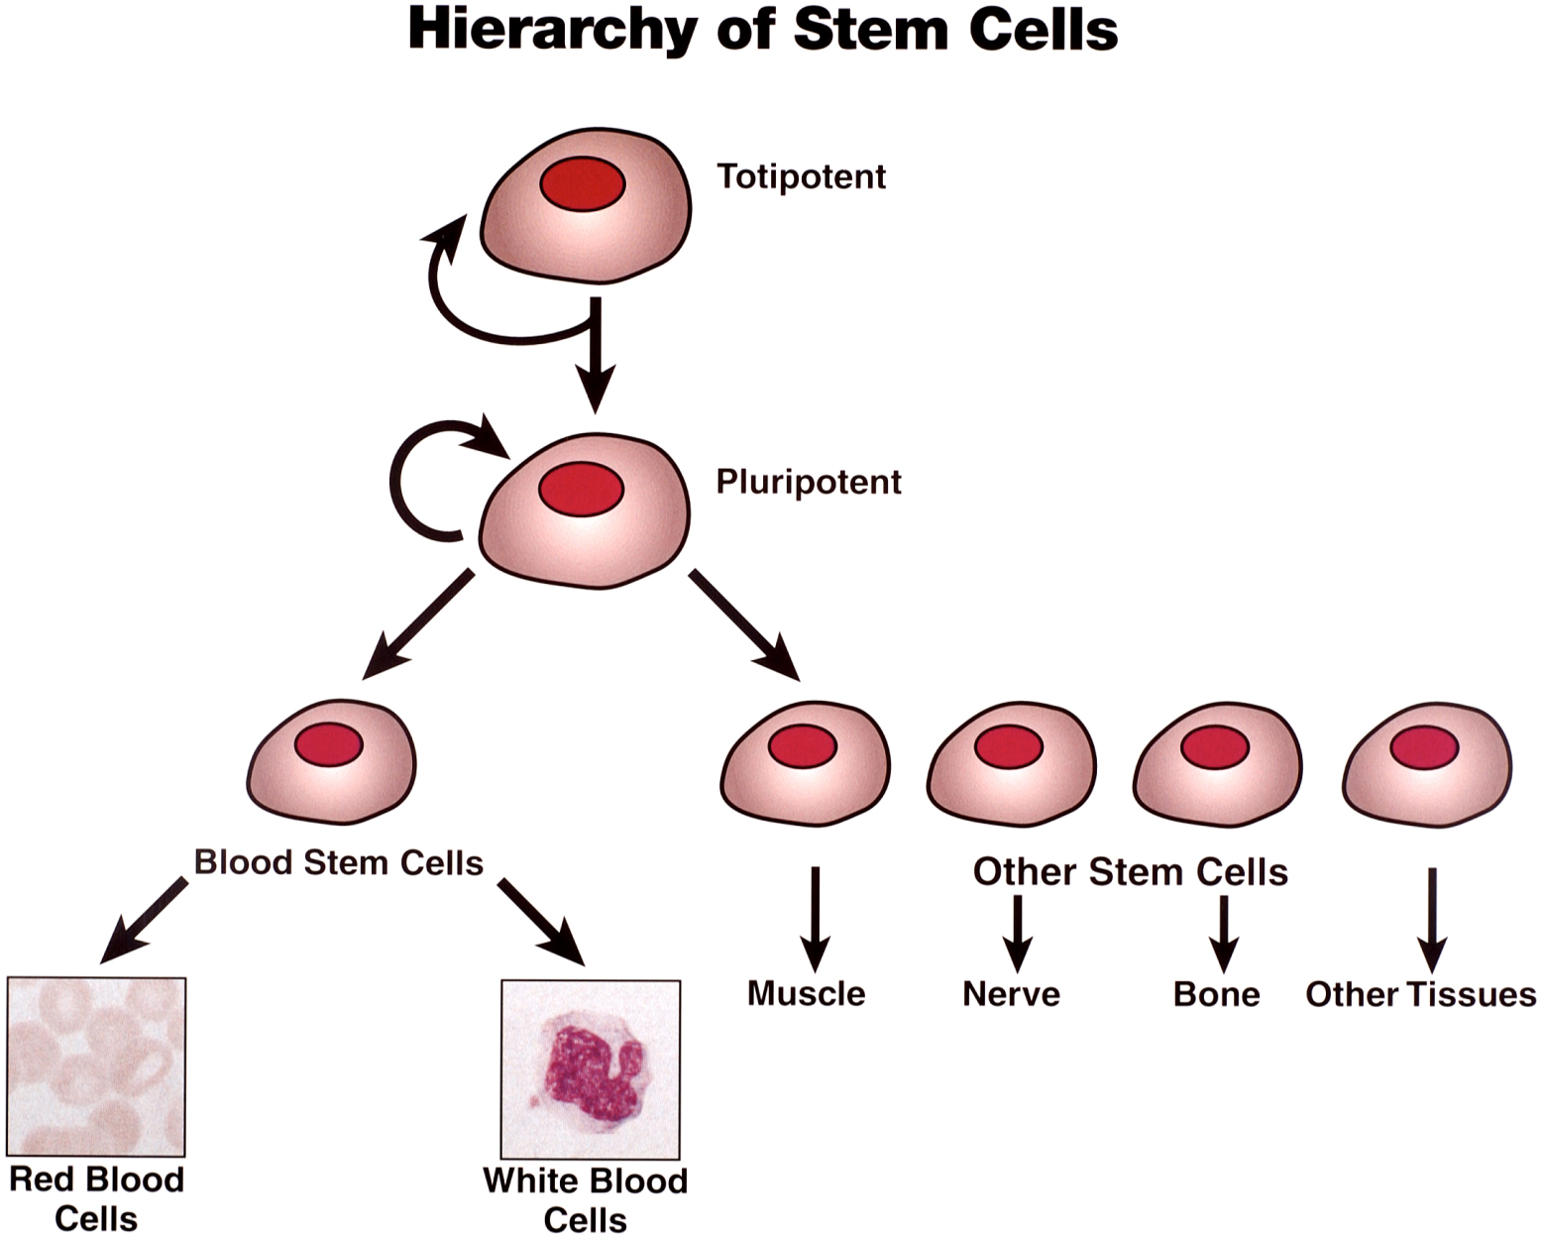
Undifferentiated cells

Slide 36
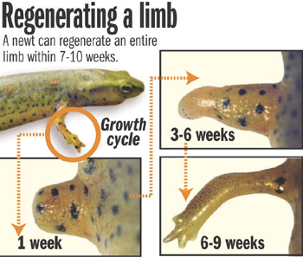

Slide 37
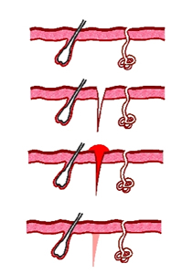
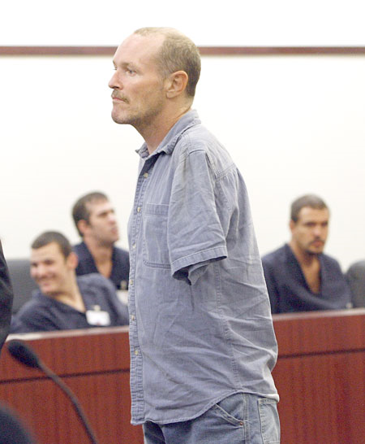
Human regeneration
Humans can only regenerate
If existing cells are still there
We are not able to
Regenerate whole
limbs

Slide 38
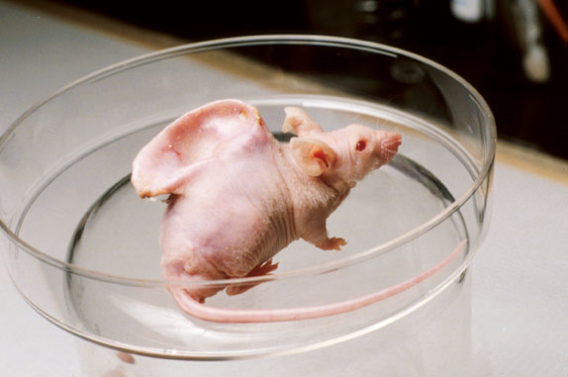
But what if we could?

Slide 39
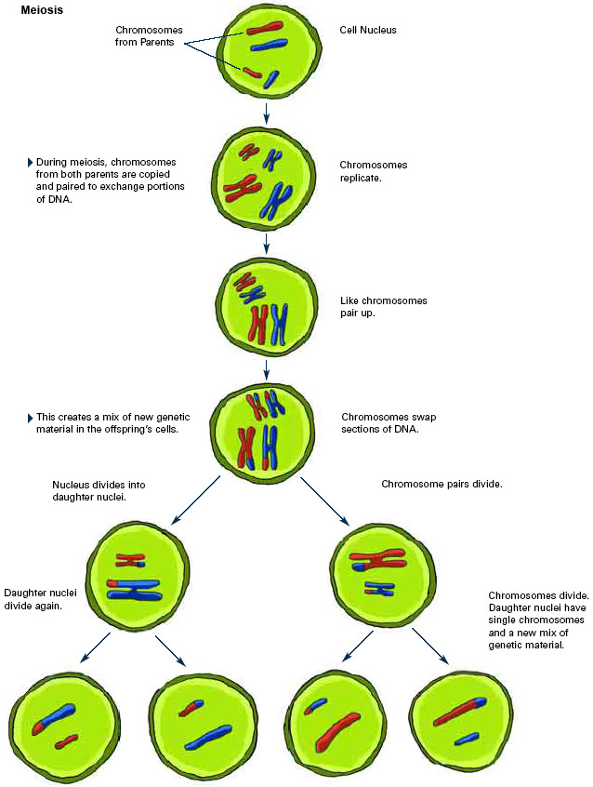

Slide 40
MEIOSIS

Slide 41
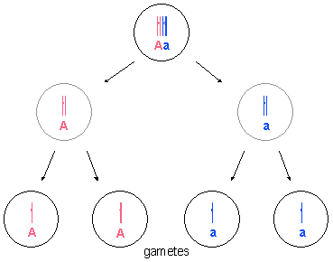
Gametes – sex cells (egg cell/sperm)

Slide 42
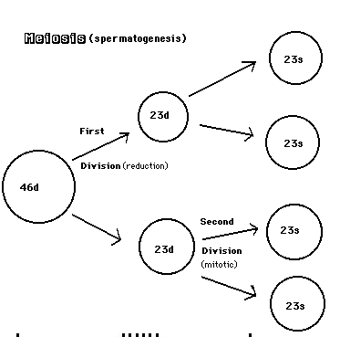

Slide 43
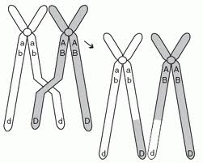
Meiosis

Slide 44
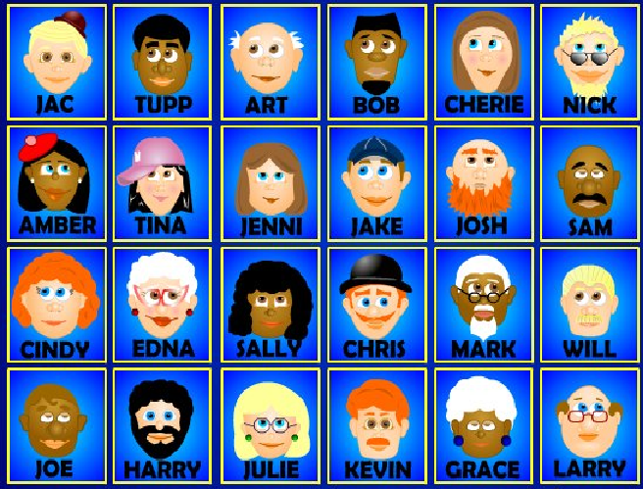
Pick two parents – list for each skin colour, hair colour, straight/curly hair, eye colour, face shape. Make (list/draw) an offspring

Slide 45
Variation

Slide 46
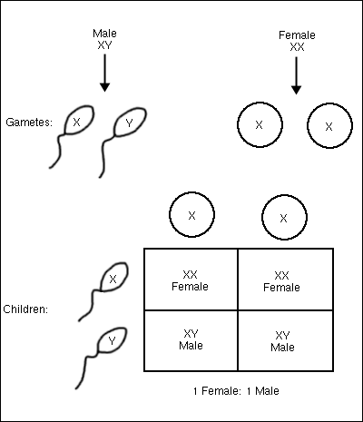
Inheritance of sex

Slide 47
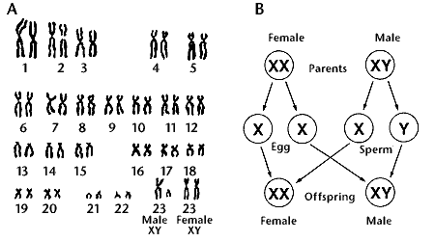

Slide 48
Key Words
Genotype Phenotype
Homozygous Hertrozygous
Homologous
Alleles
Dominant Recessive (co-dominance)

Slide 49
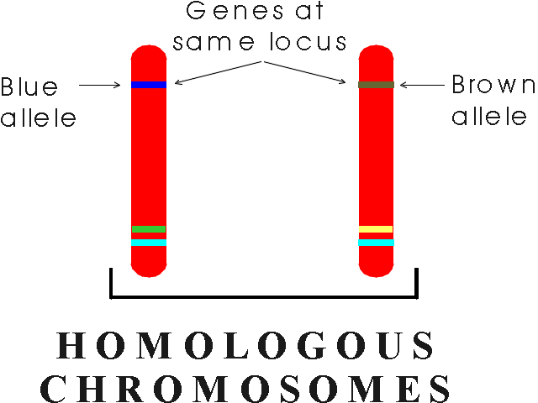
Alleles

Slide 50
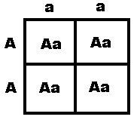
Dominant alleles – hetrozygous or homozygous

Slide 51
Recessive alleles – homozygous alleles

Slide 52
examples
Dominant Recessive
Freckles F no freckles f
Dark hair H light hair h
Tongue rollers T non-tongue rollers t
Free ear lobe E ear lobe joined e

Slide 53
Do punnett square crosses give ratio of possible genotype and phenotype of offspring
Father is hetrozygous for freckles, mother homozygous for no freckles
Father homozygous for dark hair mother homozygous for light hair
Father hetrozygous for tongue rolling, mother hertozygous for tongue rolling

Slide 54
Genetic Disorders
Huntington’s disease is a disorder of the nervous system caused by a dominant allele of a gene and can therefore be passed on by only one parent who has the disorder
Cystic fibrosis must be inherited from both parents. The parents may be carriers of the disorder without having the disorder themselves. It is caused by a recessive allele of a gene and can therefore be passed on by parents that do not have the disorder
Embryos can be screened for alleles of these and other disorders

Slide 55
Genetic family trees

Slide 56
Consult your partner and assess the probability of these genetic disorders being passed on to the children

Slide 57
In Books
Work out the probability of genetic disorders being passed on
Produce a report for the family of
William has huntingtons disease – what is the probability of Kristi getting huntingtons
Show David and Jessica how you came to that conclusion
Both Mary and Peter are carriers of the CF gene – advise them of the probability of their children getting cystic fibrosis
Explain to them how you calculated the probability
Anne has CF – and is thinking about getting married and starting a family – what advice would you give her?

