Slide 1
AQA Additional Chemistry

Slide 2
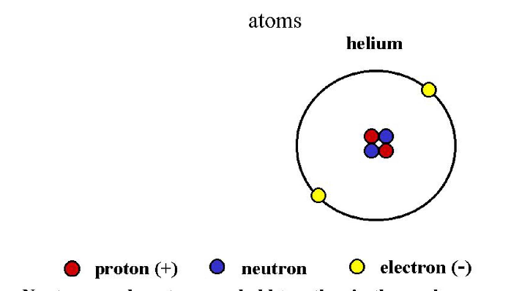
Structure of Atoms

Slide 3
Complete this table
Particle | Position | Charge | mass
Proton |  |  | 1
 | Nucleus
 |  | Negative

Slide 4
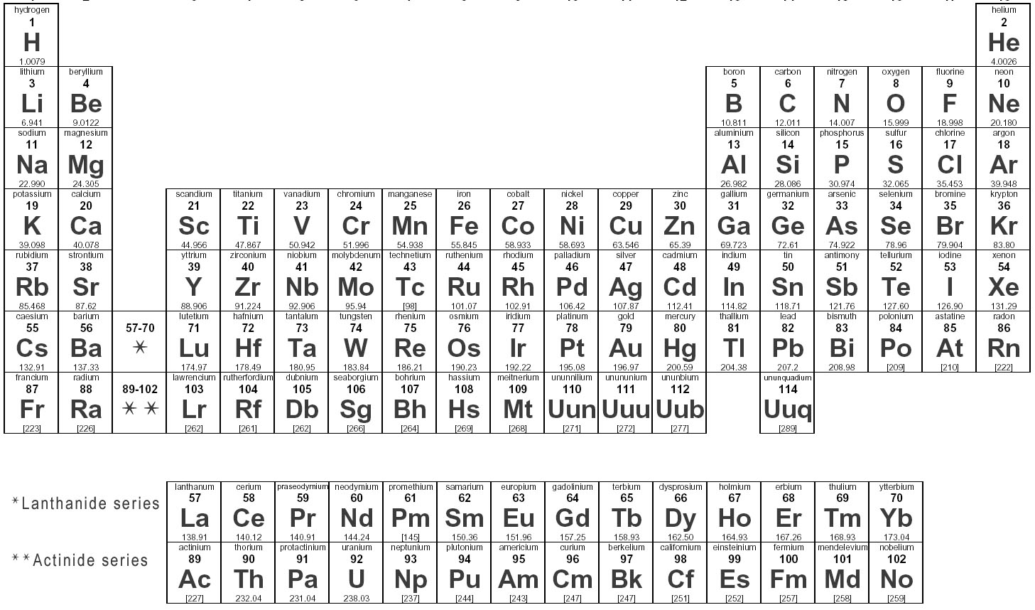
Elements in the periodic table are arranged in order of their atomic number

Slide 5
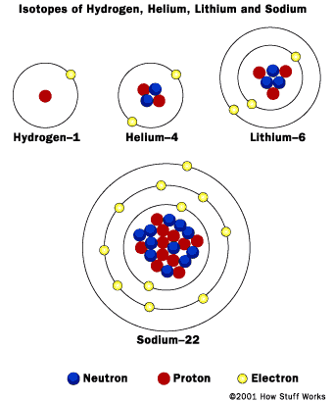
Different atoms different numbers
For each atom
List in a table
name
Proton number
Atomic Number
Electron number
Neuron number
Mass number

Slide 6
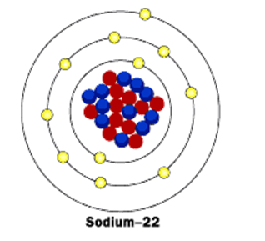
Electron shells
1. How many electron in the first (inner) shell?
2. How many in the 2nd shell?
3. there is space for 8 in the 3rd shell – but how many are there?
Electron arrangement:
2,8,8

Slide 7
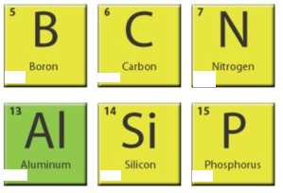
Back of Books
How many Protons, neutrons, electrons in each
What is the mass number and atomic number of each
What is the electron configuration of each

Slide 8
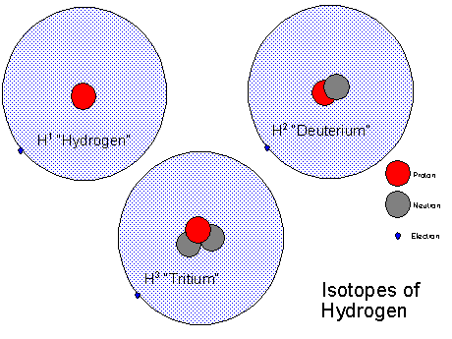
Isotopes of Hydrogen

Slide 9
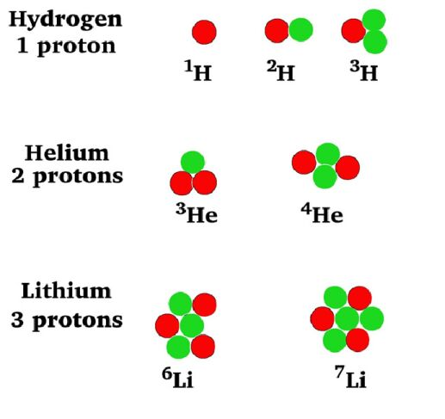
Isotopes
Choose one and construct a table showing
Proton number
Neutron number
Electron number
Atomic number
Mass number for both
Explain why the atomic number is the same for both isotopes

Slide 10
Atomic structure and isotopes
1. what is the proton number
2 the neutron number
3. the mass number
4. the electron number
5. the Atomic number
6. the electron configuration
7. Which particles are positive
8. Which are negative
6
C
14

Slide 11

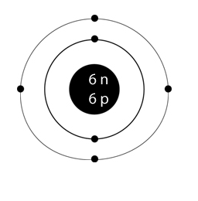

Example

Slide 12
Properties of Carbon
Atomic number 6
Mass number 12
At room temp: Solid
Conducts electricity
Non-metal
Burns slowly in air to form Carbon dioxide

Slide 13
Back of books – atomic structure/isotopes
1. there are 3 types of particle in an atom
What are they (a),(b), (c).
(a) (b) (c) charge, mass, position
Atomic Number is = to ......
There are 3 isotopes of hydrogen
Name the two numbers that will be different

Slide 14
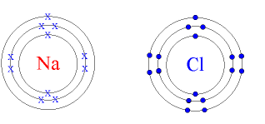

Slide 15
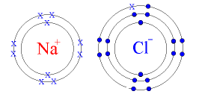

Slide 16
Results
1. what shape are the grains?
2. does sodium chloride have a high melting point (e.g. Above 100oC)?
3. Is Sodium chloride soluble in water?
4. does solid Sodium Chloride conduct electricity
5. Does sodium chloride in solution conduct electricity

Slide 17
Ionic compounds
1. an ionic particle has a non-zero what?
2. atoms can form ions with a single negative charge – to do this they must what?
3. do ionic molecules dissolve in water
4. do ionic molecules conduct electricity as
a solid
5. in sloution?

Slide 18
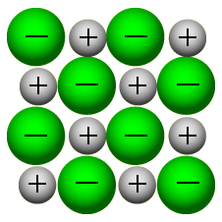

Slide 19
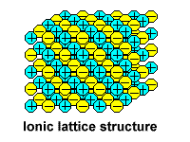

Slide 20
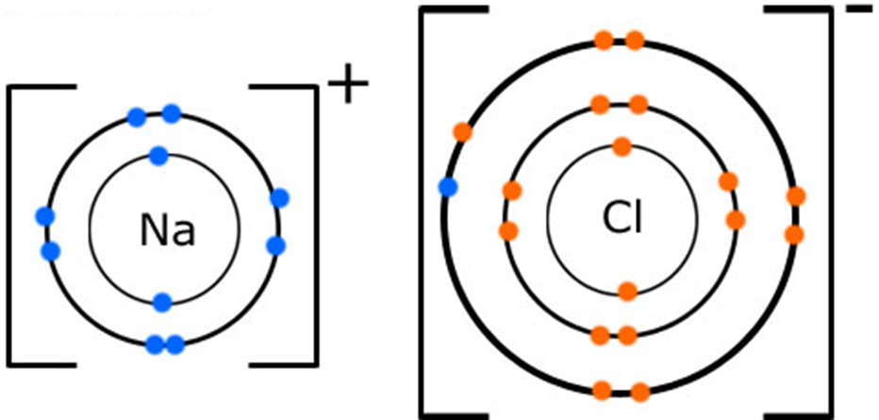

Slide 21
Ionic bonding
What is an ion
Which 2 groups bond ionically
Which group increases reactivity as you go up
Which group increases reactivity as you go down
How is a metal ion represented

Slide 22
Covalent Bonding
Know that
Covalent bonds are formed when atoms SHARE electrons
Often covalent molecules are very small molecules (gas at room temperature), but occasionally very big (solid at room temperature)
(NB ionic bonds give and take electrons – usually big)

Slide 23
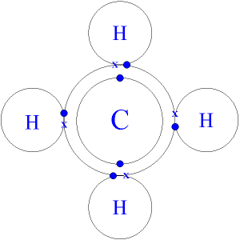
Carbon and Hydrogen CH₄

Slide 24
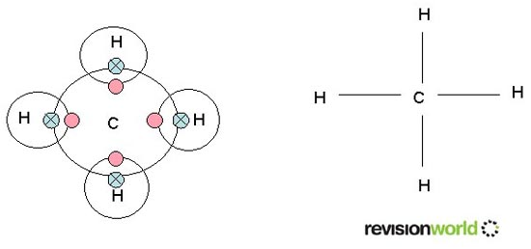
Simplifying diagrams

Slide 25
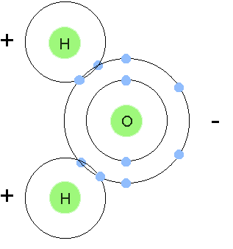
Water H₂O is a covalent bond

Slide 26
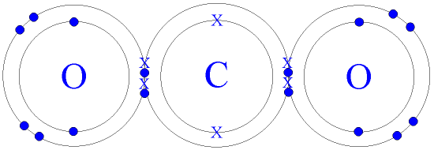
Carbon dioxide CO₂

Slide 27
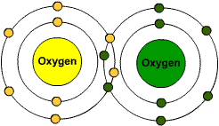
O₂

Slide 28
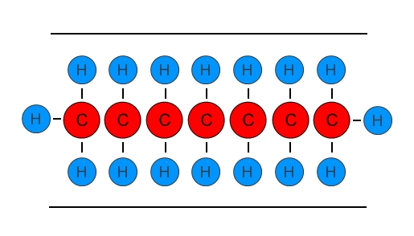
Carbon to carbon covalent bonds very long chains

Slide 29
1a, different elements chemically bonded together
1b, where atoms are held tightly together
1c, where electrons are shard between atoms
1d, in a mixture there are different molecules
2a, electrons
2b, very small molecule, no overall charge
3c covalent
3d, bonds within an atom are stronger

Slide 30

Carbon atoms

Slide 31
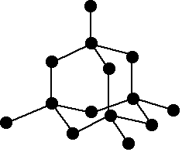
Diamond – all carbon atoms

Slide 32
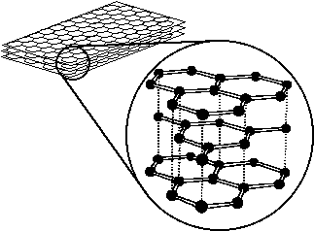
Graphite – all carbon atoms

Slide 33
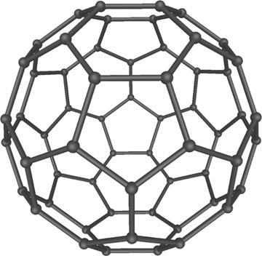
Fullerene – all carbon atoms

Slide 34
Explain why diamond is so strong and graphite can be used in pencils

Slide 35
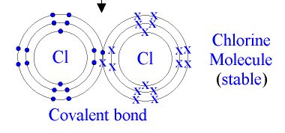
What does covalent mean
Do metals bond covalently
Chlorine Cl₂ Cl – Cl
Oxygen
Ammonia NH₃

Slide 36
Halogens
What patterns are there in group 7, the Halogens
1. how many spaces in their outer shells
2. what substances do they bond ionically with

Slide 37
Group 7 the Halogens
Halogen Molecule | Colour | State at 20oC
 | Pale yellow
 | Yellow/green
 | Orange/brown
 | Grey/black
Halogens dissolved in water
Use a dropper to put a few drops on UI paper
Which is the most acidic
Chlorine, bromine, iodine

Slide 38
Metallic bonding
Why can we bend and shape metals
Why are metals good conductors of electricity and heat

Slide 39
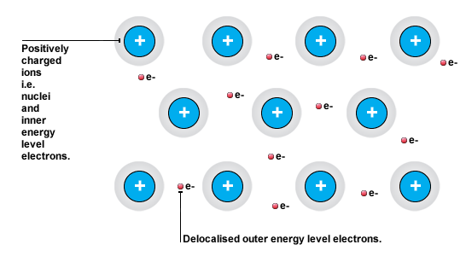
Delocalised electrons

Slide 40
Metals
Can be bent into different shapes and pulled out into thin wires, because their atomic structure acts like sheets of paper that can slide past each other
The outer electrons move around like a sea, or cloud and are not attached to one atom, but shared by all. When these electrons move they can conduct heat or electricity

Slide 41
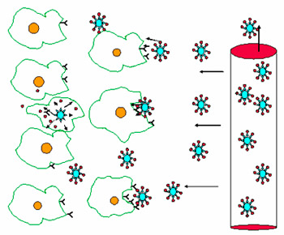
Nanoparticles - nanotechnology
Active tumor targeting of nanoparticles [11] involves attaching molecules, known collectively as ligands, to the outsides of nanoparticles. These ligands are extraordinary in that they can recognize and bind to complementary molecules, or receptors, found on the surface of tumor cells.

Slide 42
Metallic bonds and delocalised electrons
www.skoool.co.uk
Ks4 Chemistry
Bonding
Second to last slide first, then start at the top

Slide 43
Lesson objectives
Know how to balance chemical equations (H)
Know that properties of materials are a product of their chemical bonding

Slide 44
H
H
2H₂
H
H
O
O
O₂
What is this?
How many can you
Make from 2H₂ and
O₂

Slide 45

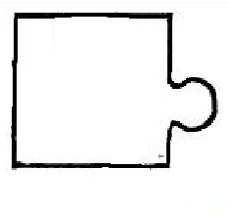
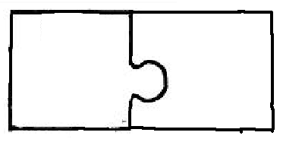

Slide 46
You try these (you can’t change the formula – only how many you have)
H₂ + Cl₂ HCl
Ca + O₂ CaO
Na + Cl₂ NaCl

Slide 47
H₂ + N₂ NH₃
C₃H₈ + O₂ CO₂ + H₂O
Al + CuO Al₂O₃ + Cu
I₂ + Na₂S₂O₃ NaI + Na₂S₄O₆
K₂O + H₂O KOH
Mg + P₄ Mg₃P₂

Slide 48
3H₂ + N₂ 2 NH₃
C₃H₈ + 5O₂ 3CO₂ + 4H₂O
2Al + 3CuO Al₂O₃ + 3Cu
I₂ + 2Na₂S₂O₃ 2NaI + Na₂S₄O₆
K₂O + H₂O 2 KOH
6Mg + P₄ 2Mg₃P₂

Slide 49
Properties of materials
Which 2 types of elements make ionic bonds
Why are they often giant compounds
Why are they usually gases
Which 2 types of elements make covalent bonds
Why do metal conduct heat and electricity well
Why is diamond hard
Why is graphite used in pencils
Use AQA text book and revision guide to help

Slide 50
RFM
What is Relative Formula mass
How to work out RFM

Slide 51
Relative Formula Mass
Hydrogen has a mass of 1
Oxygen has a mass of 16
What is the RFM of water?

Slide 52
Carbon has a mass of 12
Oxygen has a mass of 16
What is the RFM of Carbon dioxide?

Slide 53
Try
MgO
CH₄
LiOH
C₂H₅OH
Na₂SO₄

Slide 54
MgO Mg=24,O= 16, 24+16=40
CH₄ C=12,H=1, 12+1+1+1+1=16
LiOH Li=7,O=16,H=1, 7+16+1=24
C₂H₅OH C=12,H=1,O=16, 12+12+1+1+1+1+1+16+1=46
Na₂SO₄ Na=23,S=32,O=16
23+23+32+16+16+16+16=142

Slide 55
Yield and atom economy
It is important to maximise yield and atom economy to conserve resource and reduce pollution

Slide 56
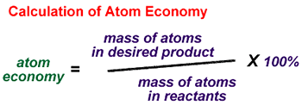
Yield and Atom economy
Percentage yield = actual yield x 100%
maximum yield

Slide 57
Some calculations
1. a chemical reaction could produce 2.5g of product, but only 1.5g was produced – what was the percentage yield
2. ethanol (C₂H₅OH) can be converted into ethene (C₂H₄) what is the percentage atom economy (NB use the atomic masses)

Slide 58
Some calculations
1. a chemical reaction could produce 2.5g of product, but only 1.5g was produced – what was the percentage yield
% yield = (1.5g/2.5g) x 100% = 60%

Slide 59
Atom economy
2. ethanol (C₂H₅OH) can be converted into ethene (C₂H₄) what is the percentage atom economy (NB use the atomic masses)
C=12, H=1, O=16
ethene 2x12 + 4x1 = 28
ethanol 2x12 + 6x1 + 16 = 56
So % atom economy = (28/56) x 100% = 61%

Slide 60
Answers
a. 24.4
b. Minimises the effect of mistakes/errors
c. Range is 8 cm3 (140 – 148)
d. Sensitive to 1/100th gram
e. Do repeats/the group closest to the average results
f. Some gas will escape each time before the bung is put on

Slide 61
Back of books
1. what is the % yield if the reactants weigh 10g and the products weigh 2g
2. what is the % atom economy of
Na + Cl₂ NaCl

Slide 62
answers
1. (2g/10g) x 100% = 20% yield
2. Na = 23, Cl=35.5
So Reactants 23+35.5+35.5 = 95
Products 23+35.5= 58.5
(58.5/95) x 100% = ~ 61.6

Slide 63
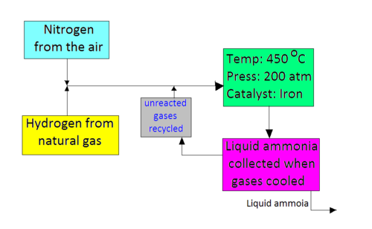

Slide 64
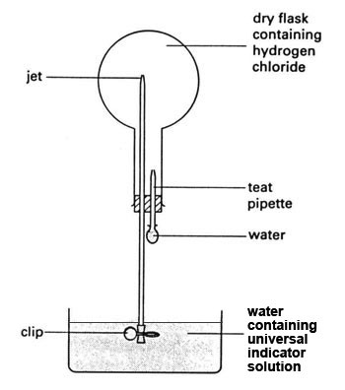

Slide 65
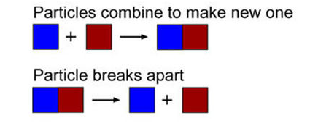
What does a reversible reaction mean?

Slide 66
Collision Theory

Slide 67
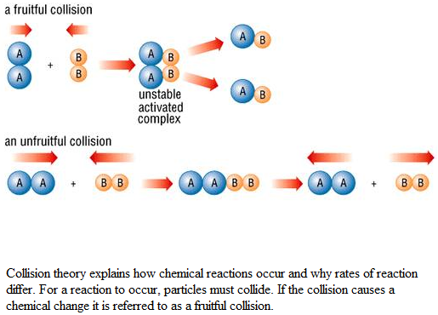

Slide 68
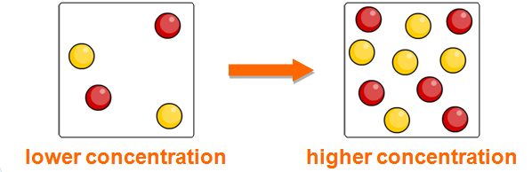
Concentration more particles – more collisions more collision – more fruitful collisions

Slide 69
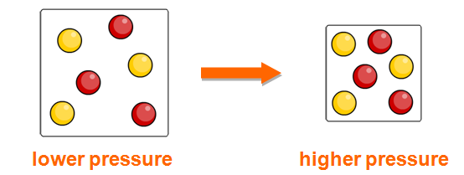
Higher pressure – more particles in the same volume
More particles – more collisions

Slide 70
Collision theory
To react, particles have to collide together
To speed up a reaction, particles have to collide together more often.
Ways to increase collisions
1. Higher temperature, particles move faster, have more collisions
2. More particles (higher concentration), more collisions
3. Increase surface area (more places to collide), more collisions
4. Use a catalyst (brings particles together), more collisions

Slide 71
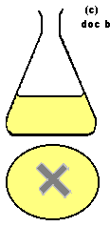
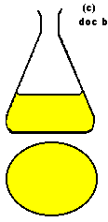
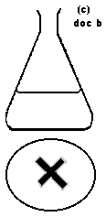
How can we increase the rate of a chemical reaction?
Particles can only react when they collide. If you heat a substance, the particles move faster and so collide more frequently. That will speed up the rate of reaction.

Slide 72
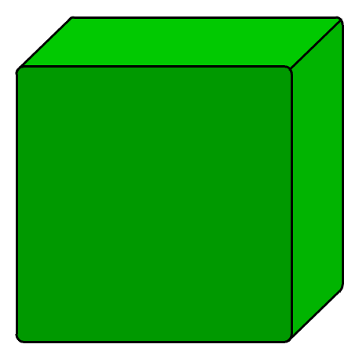
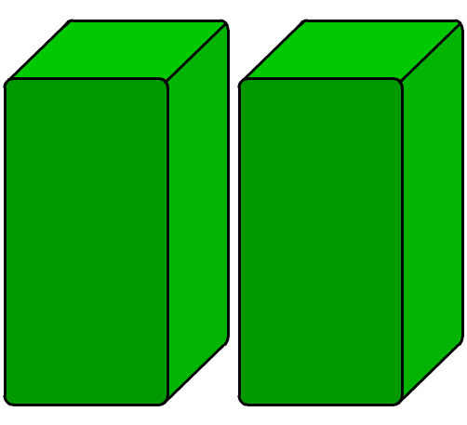
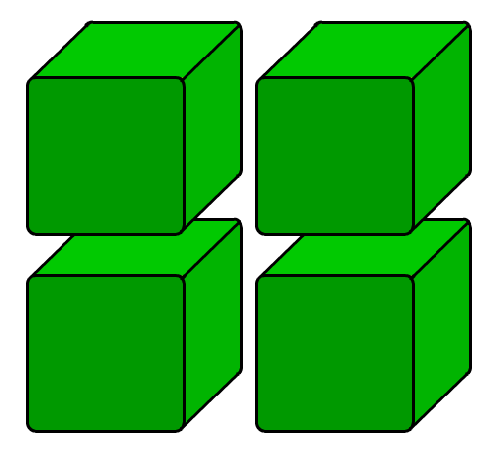
Effect of surface area on rate of reaction
Any reaction involving a solid can only take place at the surface of the solid.
If the solid is split into several pieces, the surface area increases. What effect will this have on rate of reaction?
low surface area
high surface area
This means that there is an increased area for the reactant particles to collide with.
The smaller the pieces, the larger the surface area. This means more collisions and a greater chance of reaction.

Slide 73
Results table
Gas produce (cm3)
Time (s) Large Medium Small
0
30
60
90
120
150

Slide 74
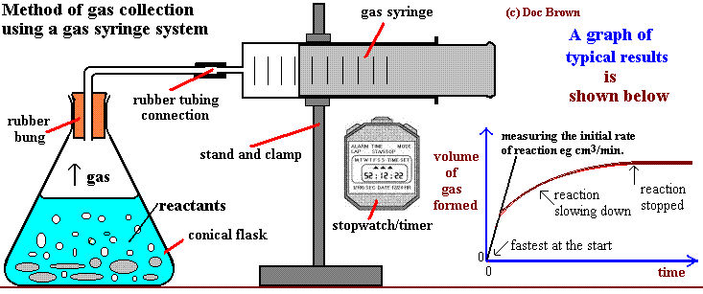
    calcium carbonate (marble chips) + hydrochloric acid ==> calcium chloride + water + carbon dioxide
      CaCO_{3(s)} + 2HCl_{(aq)} ==> CaCl_{2(aq)} + H₂O_{(l)} + CO_{2(g)}

Slide 75
Science Homework – details will be on Moodle
Set every week
Due in the first day I see you the following week
Help available after school if needed
No excuses unless a note from parents
Failure to do homework consequences –
every 2 terms:
1st time – noted
2nd time 10 min dt,
3rd time phone call home and 20 min dt
4th and further times, school 30 min detention.

Slide 76
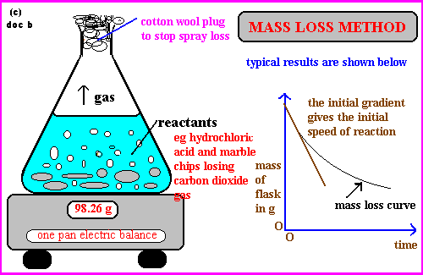

Slide 77
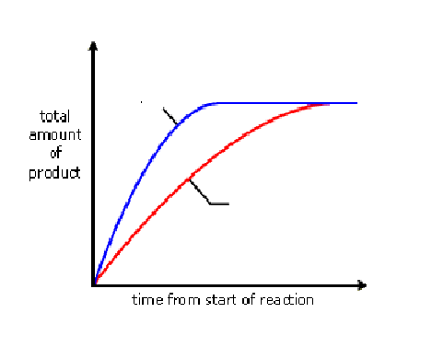
1. which reaction was the fastest
Why do they both finish at the same place
A
B

Slide 78
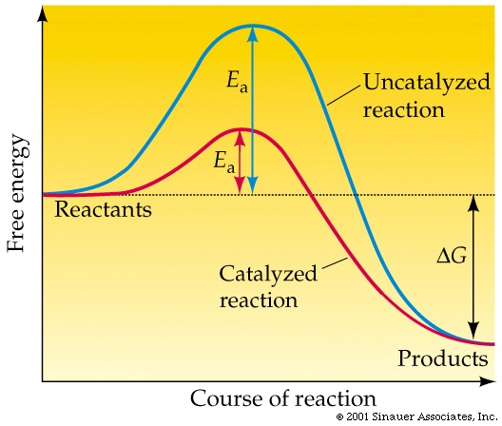
A catalyst lowers the activation energy required

Slide 79
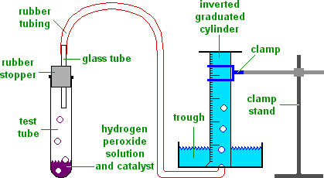
Decomposition of Hydrogen peroxide

Slide 80
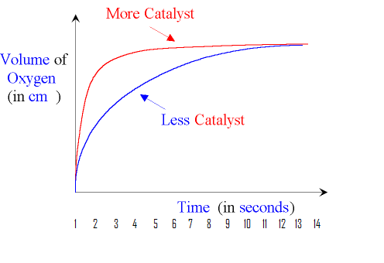
At what time
Was the
reaction fastest
Why did the reaction
gradually slow down
When was the reaction
finished

Slide 81
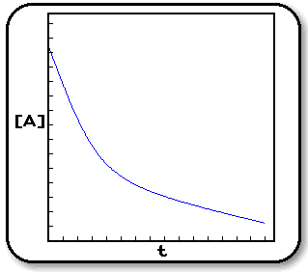
What type of
Measurement of
The rate of
Reaction
Might produce
A graph like this

Slide 82
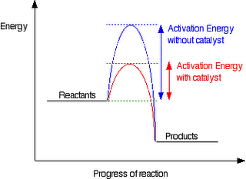
How are rates of reaction affected by a catalyst
A catalyst helps to speed up the reaction by lowering the activation energy of the reaction.
This would result in more molecules in having that minimum energy for reaction to occur.

Slide 83
Recap rates of reaction
Temperature
Surface area
Concentration
Catalyst

Slide 86
How can we increase the rate of a chemical reaction?
Particles can only react when they collide. If you heat a substance, the particles move faster and so collide more frequently. That will speed up the rate of reaction.

Slide 87
Effect of surface area on rate of reaction
Any reaction involving a solid can only take place at the surface of the solid.
If the solid is split into several pieces, the surface area increases. What effect will this have on rate of reaction?
low surface area
high surface area
This means that there is an increased area for the reactant particles to collide with.
The smaller the pieces, the larger the surface area. This means more collisions and a greater chance of reaction.

Slide 88
What are endothermic and exothermic reactions
In exothermic reactions the temperature goes up (heat is given out)
In endothermic reactions the temperature goes down (heat is taken in)

Slide 89
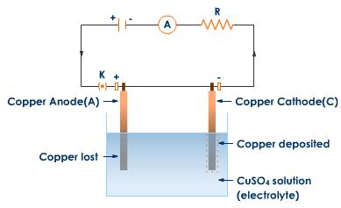

Slide 90
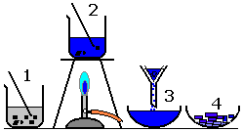

Slide 91




Slide 92


Slide 93


Slide 94


Slide 95


Slide 96


Slide 97


Slide 98


Slide 99


Slide 100


Slide 101


Slide 102


Slide 103


Slide 104



Slide 105


Slide 106


Slide 107


Slide 108


Slide 109


Slide 110


Slide 111


Slide 112


Slide 113


Slide 114


