Slide 1
AQA Additional Physics Revision

Slide 2
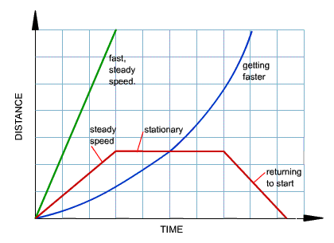
Know how to: Read distance - time graphs

Slide 3
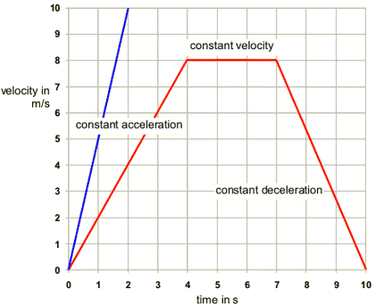
Read velocity – time graphs

Slide 4
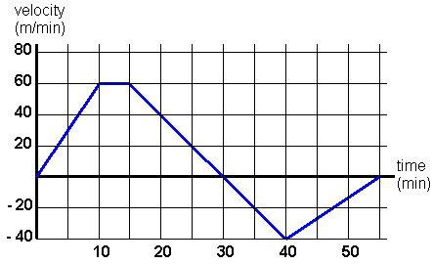

Slide 5
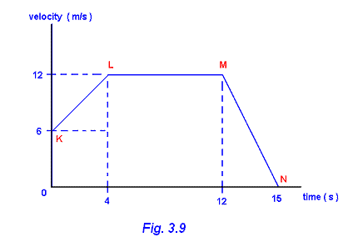
How do you calculate acceleration from a speed-time graph? Acceleration = change in velocity/time taken for the change e.g. 10m/s = 2m/s2 5s

Slide 6
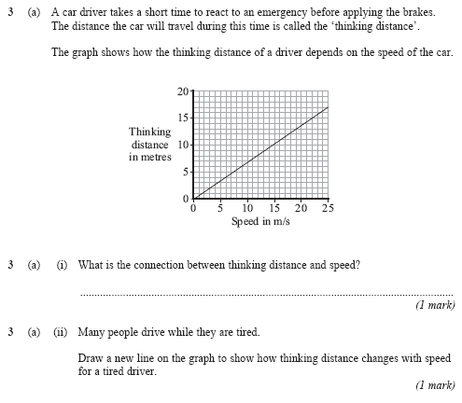

Slide 7
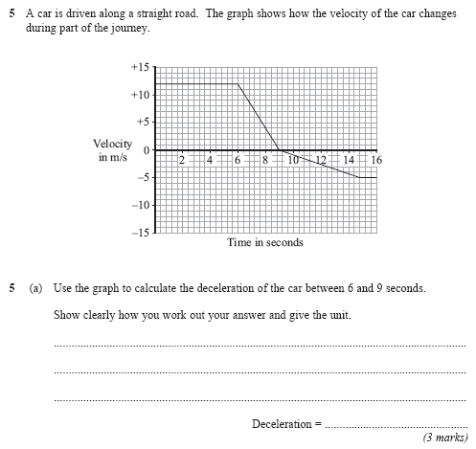

Slide 8
Be able to plot Velocity-time graphs
Bbc bitesize
Science > Additional Science (AQA) > Forces and motion > Representing motion

Slide 9
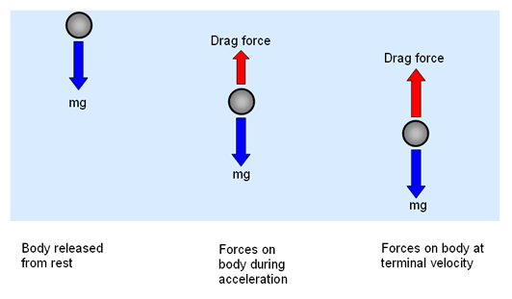
Understand terminal velocity

Slide 10
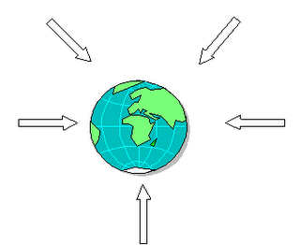
Weight= Mass x gravitational field strength

Slide 11
The factors affecting the stopping distance of a vehicle

Slide 12
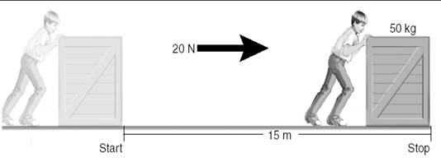
Work = force x distance moved in direction of force

Slide 13
F=MA
See bbc bitesize additional science aqa physics
Forces and motion

Slide 14
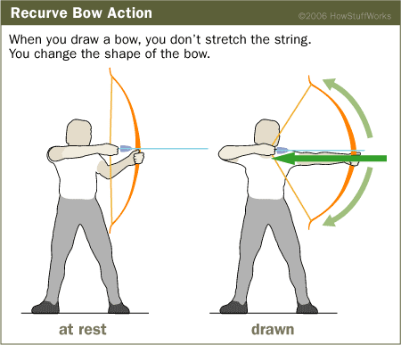
Elastic potential energy is stored in an object when a force change its shape

Slide 15
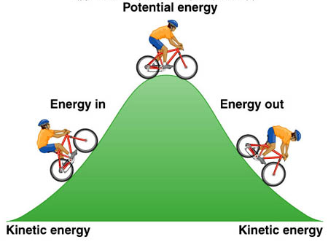
Kinetic energy depends on speed and mass

Slide 16
Kinetic energy= ½ x mass x speed
Bbc bitesize
Science > Additional Science (AQA) > Forces and motion > Kinetic energy

Slide 17
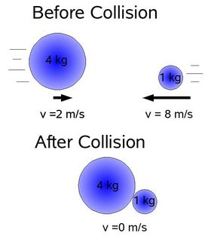
Momentum=mass x velocity Momentum has both magnitude And direction

Slide 18
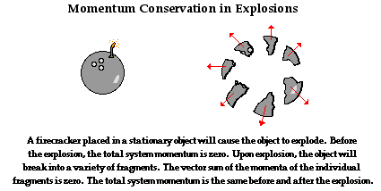
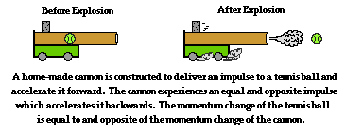

Slide 19
When a force acts on a body a change in momentum occurs Momentum is conserved in any collision/explosion provided no external forces act

Slide 20
To use the idea of momentum to explain safety features

Slide 21
Force = change in momentum/ time taken

Slide 22
How materials become charged by friction

Slide 23
Electrically charged bodies exert forces on each other; LIKE CHARGES REPEL UNLIKE CHARGES ATTRACT

Slide 24
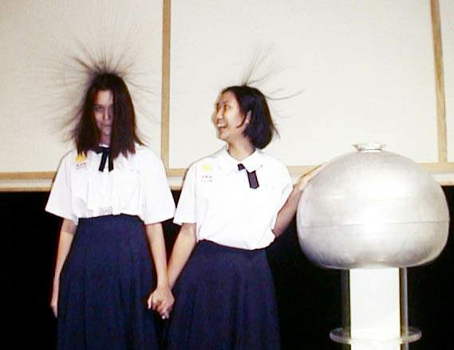
Van de Graaff generator

Slide 25
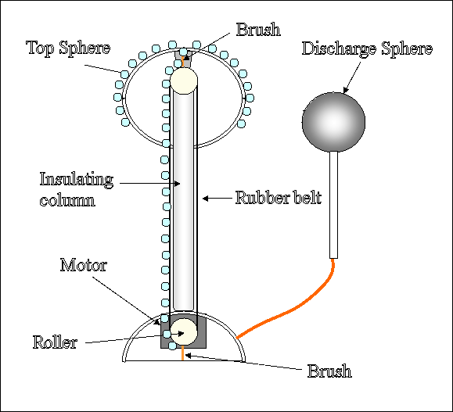

Slide 26
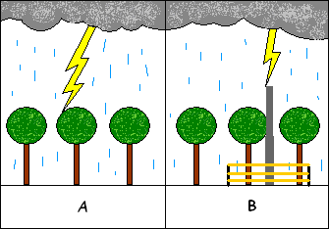
Simple diagrams showing how a lightning conductor works
Lightning conductors work to protect tall buildings from lightning strike. This is by providing an easier path for current to flow to the earth other than through the building. It consists of a thick copper strip of very low resistance connected to a large metal plate deep in the damp earth.

Slide 27
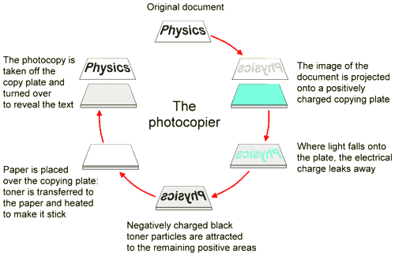
How a photocopier works

Slide 28
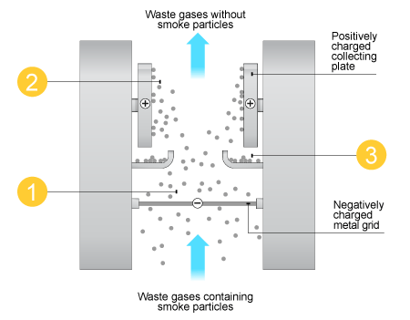
How a smoke precipitator works

Slide 29
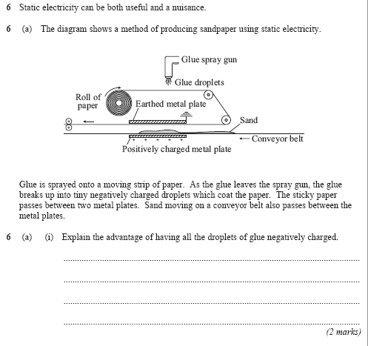

Slide 30
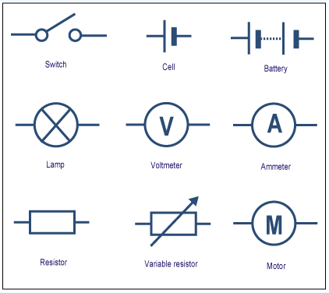
To interpret and draw circuit diagrams using standard symbols

Slide 31
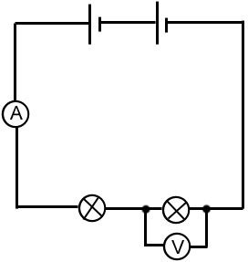
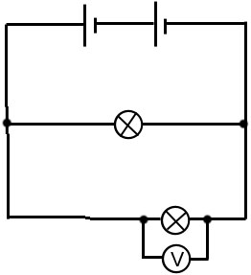
Meaning of series and parallel

Slide 32
graphs for a resistor at constant temperature, a filament lamp and a Diode

Slide 33
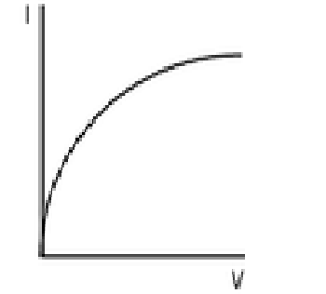
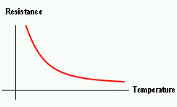
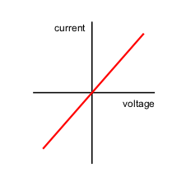
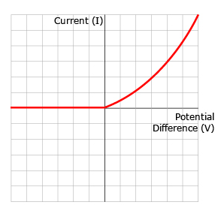
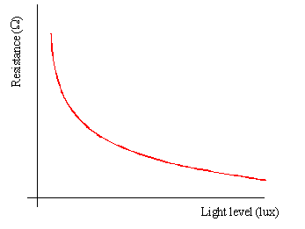
Resistance graphs

Slide 34
Potential difference (V)=current(A) X resistance(Ohms) V=IR
Pd Current resistance
2v .......... 2 ohms
......... 1.5 amps 2 ohms
4v 2 amps ..........
.......... 3 amps 2 ohms
A p.d. of 4v is applied to two resistors (6 ohms and 2 ohms) connected in series
What is
1. the combined resistance
2.the current flowing
3. the p.d. across the 6 ohm resistor

Slide 35
A p.d. of 4v is applied to two resistors (6 ohms and 2 ohms) connected in series - What is 1. the combined resistance 2.the current flowing 3. the p.d. across the 6 ohm resistor
Pd Current resistance
2v .I amp 2 ohms
.3v 1.5 amps 2 ohms
4v 2 amps 2 ohms
.6 v 3 amps 2 ohms
1. 6 + 2 = 8 ohms (NB only in series circuits)
2. I = V/R = 4/8 = 0.5 amps
3. V = IR = 0.5 x 6 = 3V

Slide 36
For components connected in series The total resistance is the sum of the resistance of each component There is the same current through each component The total pd of the supply is shared between the components

Slide 37
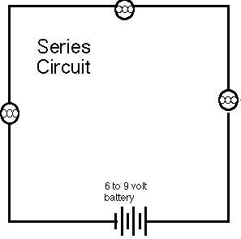
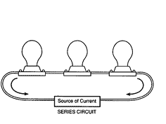
Series circuit

Slide 38
For components in connected in parallel The pd across each component is the same The total current through the whole circuit is the sum of the currents through the separate components

Slide 39
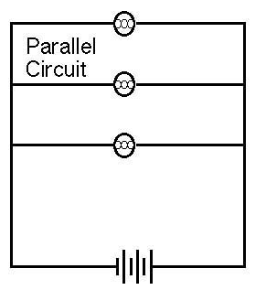
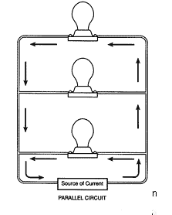
Parallel circuit

Slide 40
Cells and batteries supply current which always passes in the same direction. This is called direct current (dc)

Slide 41
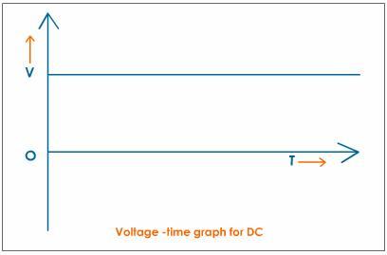

Slide 42
An alternating current (ac) is one which is constantly changing direction. Mains electricity is an ac supply. In the UK it has a frequency of 50 cycles per second (50 hertz)

Slide 43
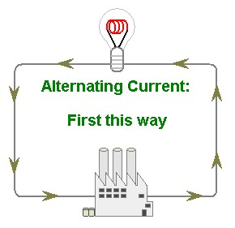
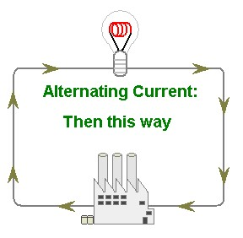
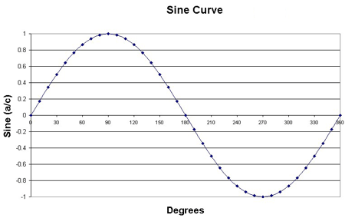

Slide 44
UK mains supply is about 230 volts To determine the period and hence the frequency of a supply from the diagrams of oscilloscope traces.

Slide 45
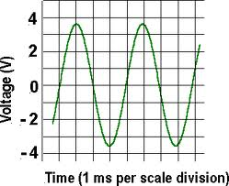
To find frequency 1 period is ~ 3.5 ms or 0.0035s Frequency = 1/0.0035=285 Hz

Slide 46
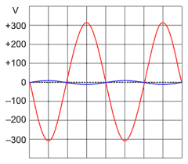
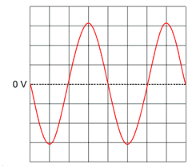
Find frequency
Each division = 10 ms
Each division = 1ms
Each division = 5 ms

Slide 47
1 period is 4 x 1 = 4ms
4 ms = 0.004s
Frequency = 1/0.004 = 250 Hz
1 period is 4 x 10 = 40ms
4 ms = 0.04s
Frequency = 1/0.04 = 25 Hz
1 period is 4 x5 = 20ms
4 ms = 0.02s
Frequency = 1/0.02 = 50 Hz
THIS IS THE SAME A UK MAINS ELECTRICITY

Slide 48
Questions
1. what is the difference between ac and dc current
2. what is the frequency of UK mains electricity
3. How does the potential (voltage) vary with each cycle

Slide 49
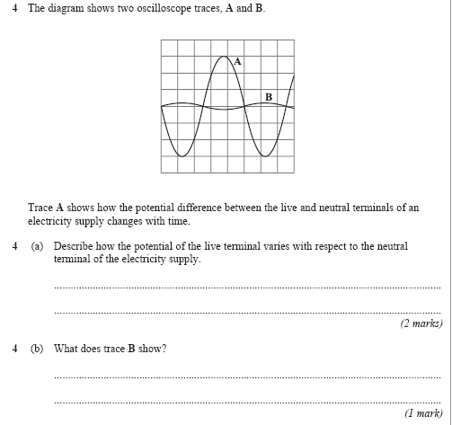

Slide 50
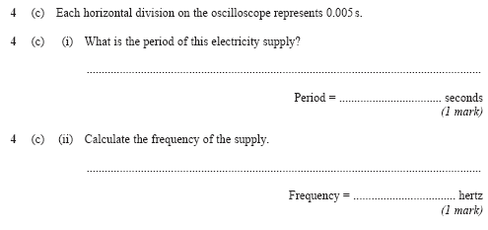

Slide 51
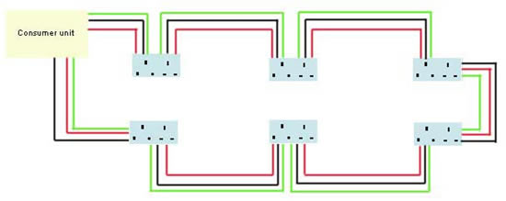
Mains Electricity Most electrical appliances are connected to the mains using cable and a three-pin plug

Slide 52
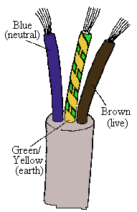
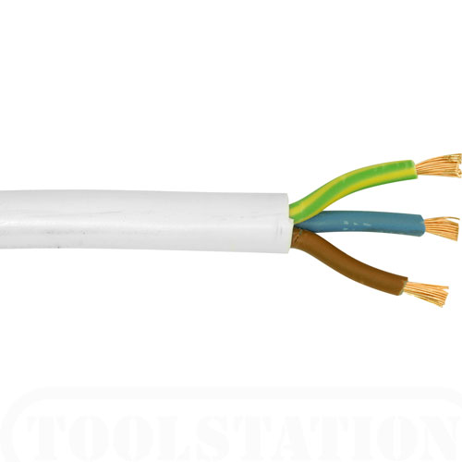
The structure of electric cable

Slide 53
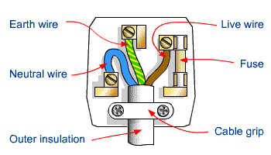
The structure of a three-pin plug Correct wiring of a three-pin plug

Slide 54
Electrical safety To recognise errors in the wiring of a plug
The plug
The features of a plug are:
The case is made from tough plastic or rubber because these materials are good electrical insulators.
The three pins are made from brass, which is a good conductor of electricity.
There is a fuse between the live terminal and the live pin.
The fuse breaks the circuit if too much current flows.
The cable is secured in the plug by a cable grip. This should grip the cable itself and not the individual wires inside it.

Slide 55
To recognise dangerous practice in the use of mains electricity

Slide 56
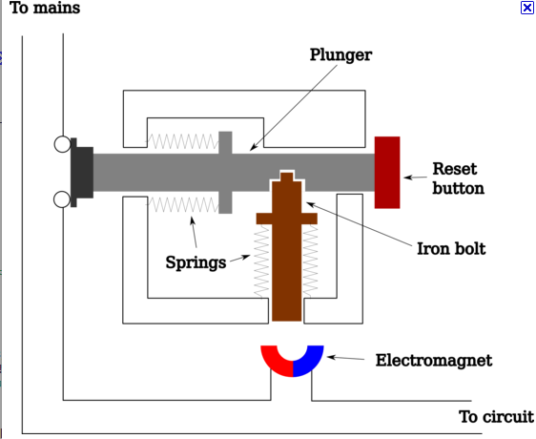
If an electric fault causes too great a current, the circuit should be switched off by a fuse or circuit breaker

Slide 57
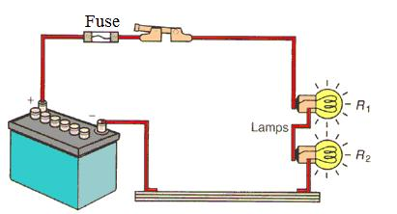
When the current in a wire exceeds the rating of the fuse it will melt breaking the circuit

Slide 58
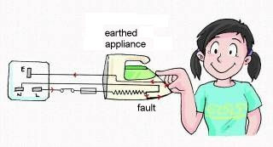
Appliances with metal cases are usually earthed The earth wire and fuse together protect the appliance and the user

Slide 59
The live terminal of the mains supply alternates between positive and negative potential with respect to the neutral terminal. The neutral terminal stays at potential close to zero with respect to the earth

Slide 60
POWER= CURRENT X PD (W) (A) (V)
Use bbc bitesize additional aqa physics electricity mains electricity

Slide 61
POWER = ENERGY (J) (W) TIME (s)

Slide 62
ENERGY = PD X CHARGE (J) (V) (C)

Slide 63
CHARGE=CURRENTX TIME (C) (A) (s)

Slide 64
Rutherford and Marsden scattering experiment led to the ‘plum pudding’ model of the atom being replaced by the nuclear model

Slide 65
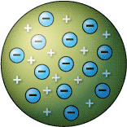
Plum pudding model

Slide 66
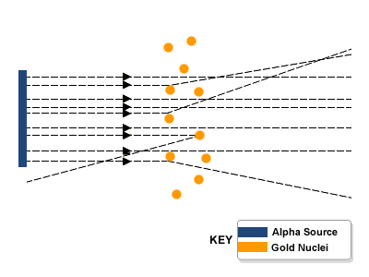
Marsden’s scattering experiment

Slide 67
Comparison

Slide 68
Rutherford’s nuclear model of the atom

Slide 69
The relative mass and relative electrical charge of protons, neutrons and electrons
 | relative mass | relative charge
proton | 1 | +1
neutron | 1 | 0
electron | 1/1836 | -1

Slide 70
In an atom the number of electrons is equal to the number of protons in the nucleus. The atom has no net electrical charge.

Slide 71
Atoms may gain or lose electrons to form charged particles called ions

Slide 72
All atoms of a particular element have the same number of protons

Slide 73
Atoms of different elements have different numbers of protons

Slide 74
Atoms of the same element which have different numbers of neutrons are called isotopes

Slide 75
The total number of protons and neutrons in atom is called its mass number

Slide 76
The effect of alpha on radioactive nuclei

Slide 77
The effect of beta on radioactive nuclei

Slide 78
Gamma Radiation

Slide 79
penetrating

Slide 80
type | ionising | Speed | penetrating
Alpha | High | slow | Low
Beta | Medium | fast | Medium
gamma | low | Very fast | high

Slide 81
The origins of background radiation

Slide 82
Background radiation

Slide 83
Radon gas from rocks

Slide 86
Nuclear fission (splitting)

Slide 87
For fission to occur the uranium 235 or uranium 239 must first absorb a neutron

Slide 88
Nuclear fission is the splitting of an atomic nucleus

Slide 89
The nucleus undergoing fission splits into two smaller nuclei and 2 or 3 neutrons and energy is released

Slide 90
There are two fissionable substances in common use in nuclear reactors, uranium 235 and plutonium 239

Slide 91
The neutrons may go on to start a chain reaction Students should be able to sketch a labelled diagram to show how a chain reaction may occur
See bbc bitesize additional science aqa physics radiation

Slide 92
How a nuclear reactor works

Slide 93
The sun releases energy due to nuclear fusion of hydrogen isotopes in its core

Slide 94
Let's look at magnetic confinement first. Here's how it would work: Microwaves, electricity and neutral particle beams from accelerators heat a stream of hydrogen gas. This heating turns the gas into plasma. This plasma gets squeezed by super-conducting magnets, thereby allowing fusion to occur. The most efficient shape for the magnetically confined plasma is a donut shape (toroid).

