Slide 1
Element
Two or more elements chemically reacted together. Its difficult to separate.
Compounds
Different atomic forms of the same element, which have the same number of protons but a different number of neutrons.
Isotopes
One type of atom only

Slide 2
Element
Two or more elements chemically reacted together. Its difficult to separate.
Compounds
Different atomic forms of the same element, which have the same number of protons but a different number of neutrons.
Isotopes
One type of atom only

Slide 3
Isotopes!
You need to learn this definition!
Different atomic forms of the same element, which have the same number of protons but a different number of neutrons
So for example a popular pair of isotopes ,
6 protons
6 neutrons
6 electrons
6 protons
8 neutrons
6 electrons
c
c
12
6
14
6

Slide 4
The periodic table
Elements in order of ascending atomic number
The periodic table is laid out so that the elements with similar properties form columns
These vertical columns are called groups and roman numerals are often ( but not always ) used for them
The group to which the element belongs corresponds to the number of electrons it has in its outer shell. E.g. group 1 have 1 outer shell ELECTRON as group 7 has 7 outer shell ELECTRONS.
Elements in a group have the same number of outer electrons which is why they have similar properties.

Slide 5
Electron shells
The rules: true or false?
Electrons don’t always occupy shells
The lowest energy levels are always filled first- these are the ones closest to the nucleus.
Only a certain number are allowed in each shell e.g. 3 in the first 7 in the second 7 in the third and 3 in the fourth.
Atoms are much happier when they have full electron shells- like the noble gases in group 0.
In most atoms the outer shell is full which makes them want to react.

Slide 6
Electron shells
The rules: true or false?
Electrons don’t always occupy shells
The lowest energy levels are always filled first- these are the ones closest to the nucleus.
Only a certain number are allowed in each shell e.g. 3 in the first 7 in the second 7 in the third and 3 in the fourth.
Atoms are much happier when they have full electron shells- like the noble gases in group 0.
In most atoms the outer shell is full which makes them want to react.

Slide 7
Electron shells
The rules: true or false?
Electrons always occupy shells
The lowest energy levels are always filled first- these are the ones closest to the nucleus.
Only a certain number are allowed in each shell e.g. 2 in the first 8 in the second 8 in the third and 2 in the fourth.
Atoms are much happier when they have full electron shells- like the noble gases in group 0.
In most atoms the outer shell is not full which makes them want to react.

Slide 8
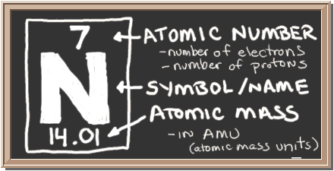
Configuration rules
If the number of protons is 7 then so is the number of electrons,
If we follow the 2 8 8 2 rule what's the configuration for nitrogen?

Slide 9
THE CONFIGURATION IS 2, 5
N

Slide 10
Find the element on the periodic table and find the configuration yourself,
Aluminium
Carbon
Fluorine
Calcium
Argon
Potassium

Slide 11
Answers
2,8,3
2,4
2,7
2,8,8,2
2,8,8
2,8,8,1

Slide 12
So what have you learnt?!
What's the difference between elements and compounds?
What's the configuration in an element?
What's an isotope?

