Slide 1
Edexcel Core Biology
Topic 1
Unit B1: Influences on life
Topic 1 Classification, variation and inheritance

Slide 2
Classification
Key words: characteristics, unicellular, multicellular, nucleus, autotrophic, photosynthesis, heterotrophic, saprophytic, virus

Slide 3
Detailed unit content
In this specification bold text refers to higher tier only content. Italic text refers to practical investigations, which students are required to demonstrate an understanding of.
Topic 1
Classification, variation and inheritance
1.1 Demonstrate an understanding of how biologists classify organisms according to how closely they are related to one another including:
a Species – groups of organisms that have many features in common
b Genus – contains several species with similar characteristics
c Family – comprising of several genera
d Order – comprising of several families
e Class – comprising of several orders
f Phylum – comprising of several classes
g The Five Kingdoms – animalia, plantae, fungi, protoctista and prokaryotes
1.2 Describe the main characteristics of the five kingdoms including:
a Animalia – multicellular, do not have cell walls, do not have chlorophyll, feed heterotrophically
b Plantae – multicellular, have cell walls, have chlorophyll, feed autotrophically
c Fungi – multicellular, have cell walls, do not have chlorophyll, feed saprophytically
d Protoctista – unicellular, have a nucleus
e Prokaryotes – unicellular, have no nucleus
1.3 Explain why scientists do not classify viruses in any of the five kingdoms and regard them as non-living
1.4 Describe the main characteristics of the phylum Chordata as animals with a supporting rod running the length of the body, an example of this being the backbone in vertebrates

Slide 4
Modern classification system
There are millions of species on our planet. It would be difficult if we just tried to describe and name each one individually. Although species can be very different from each other, many of them have similar features that allow us to put them into groups.
In the eighteenth century Carl Linnaeus started the modern system of putting species of organism into certain groups and giving them scientific names. Each species is given a name using Latin words, so that the same name can be used all over the world.
For example, the scientific name for human beings is 'homo sapiens'. Putting different species into different groups according to their features is called classification.

Slide 5
Be able to:-
Demonstrate an understanding of how biologists classify organisms according to how closely they are related to one another, including – species, genus, family, order, class, phylum, the five kingdoms

Slide 6
Linnaeus classification

Slide 7
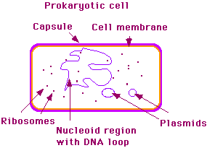
KINGDOM Prokaryote-
*1 cell *no true nucleus - prokaryote (genetic material scattered and not enclosed by a membrane) *some move (flagellum); others don't *some make their own food (autotrophic); others can't make their own food (heterotrophic) *examples - bacteria, blue-green bacteria (cyanobacteria)

Slide 8
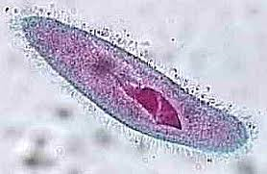
KINGDOM PROTISTA
(protists) -
*1 cell *have a true nucleus - eukaryote *some move (cilia, flagella, pseudopodia); others don't *some are autotrophic; others are heterotrophic *examples - amoeba, diatom, euglena, paramecium, some algae (unicellular), etc

Slide 9
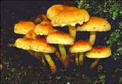
KINGDOM FUNGI
-
*multicellular *have nuclei *mainly do not move from place to place *heterotrophic (food is digested outside of fungus) *examples - mushroom, mould, puffball, shelf/bracket fungus, yeast, etc.

Slide 10
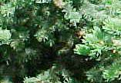
KINGDOM PLANTAE
(plants) -
*multicellular *have nuclei *do not move *autotrophic *examples –
multicellular algae, mosses, ferns, flowering plants (dandelions, roses, etc.), trees, etc

Slide 11
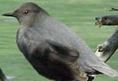
KINGDOM ANIMALIA
(animals) -
*multicellular *have nuclei *do move *heterotrophic *examples - sponge, jellyfish, insect, fish, frog, bird, humans

Slide 12
1.5 Explain how scientists place vertebrates into groups based on:
a Oxygen absorption methods – lungs, gills and skin
b Reproduction – internal or external fertilisation, oviparous or viviparous
c Thermoregulation – homeotherms and poikilotherms
1.6 Demonstrate an understanding of the problems associated with assigning vertebrates to a specific group based on their anatomy and reproduction methods and why many vertebrates are difficult to classify
1.7 Discuss why the definition of a species as organisms that produce fertile offspring may have limitations: some organisms do not always reproduce sexually and some hybrids are fertile
1.8 (H) Explain why binomial classification is needed to identify, study and conserve species, and can be used to target conservation efforts
1.9 Explain how accurate classification may be complicated by:
a variation within a species
b (H)hybridisation in ducks
c (H) ring species
1.10 Construct and use keys to show how species can be identified

Slide 13
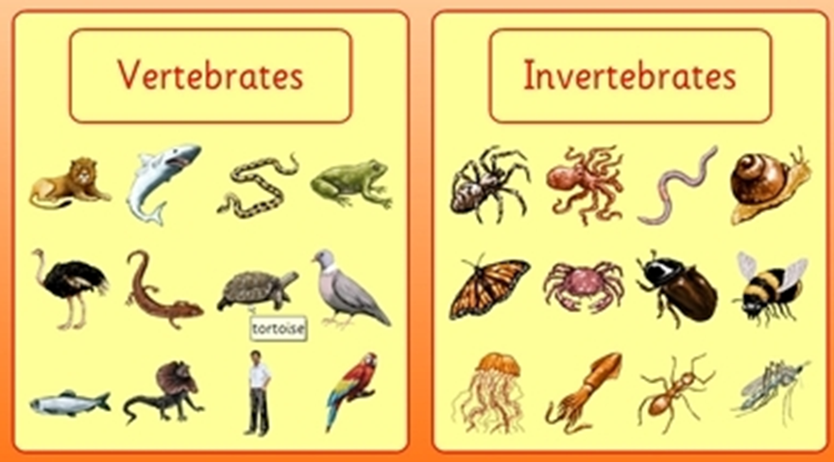

Slide 14
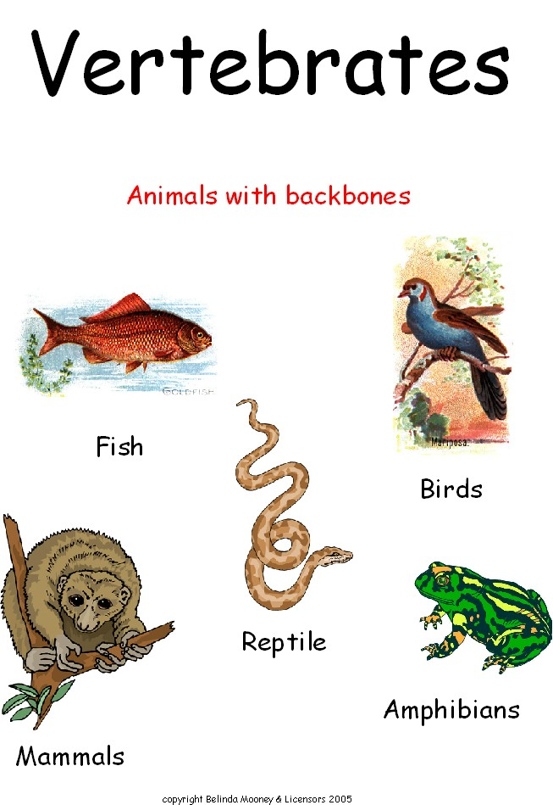

Slide 15
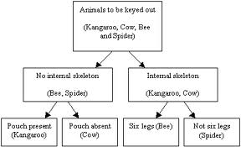
Simple classification key

Slide 16
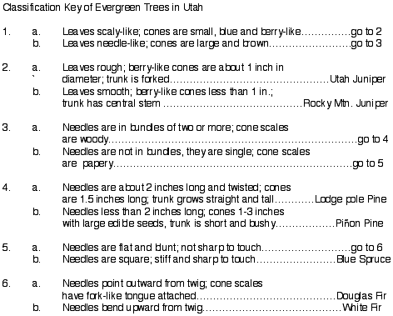
Classification key

Slide 17
1.17 Demonstrate an understanding of how speciation occurs
as a result of geographic isolation:
1.18 Explain how new evidence from DNA research and the
emergence of resistant organisms supports Darwin’s theory
1.19 Explain the role of the scientific community in validating new
evidence, including the use of:
a scientific journals
b the peer review process
c scientific conferences

Slide 18
What is a species
In biology, a species is one of the basic units of biological classification. A species is often defined as a group of organisms capable of interbreeding and producing fertile offspring. While in many cases this definition is adequate, more precise or differing measures are often used, such as similarity of DNA. Presence of specific locally adapted traits may further subdivide species into subspecies

Slide 19
Ring Species
A ring species is a connected series of neighbouring populations, each of which can interbreed with closel related populations, but for which there exist at least two "end" populations in the series, which are too distantly related to interbreed. Non-breeding "end" populations may co-exist in the same region thus closing a "ring"

Slide 20
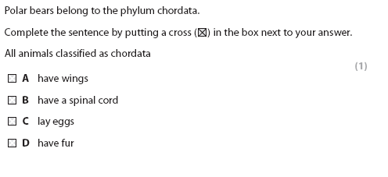
(If you don’t know – look it up in your revision guide)

Slide 21
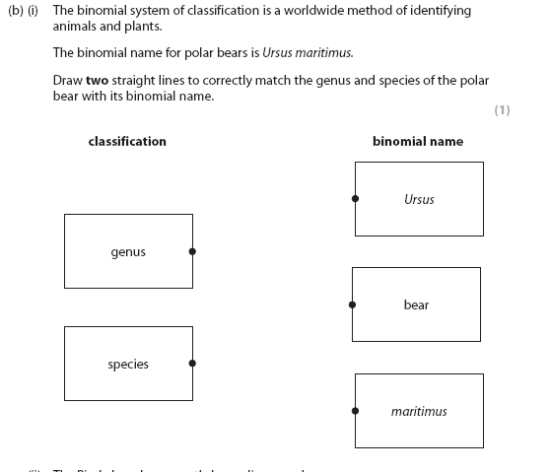
If you don’t
Know what
Genus and
Species is
Look it up

Slide 22
1.11 Explain how organisms are adapted to their environment and how some organisms have characteristics that enable them to survive in extreme environments, including deep-sea hydrothermal vents and polar regions
1.12 Demonstrate an understanding of Darwin’s theory of evolution by natural selection including:
A variation – most populations of organisms contain individuals which vary slightly from one to another
b over-production – most organisms produce more young than will survive to adulthood
c struggle for existence – because populations do not generally increase rapidly in size there must therefore be considerable competition for survival between the organisms
d survival- those with advantageous characteristics are more likely to survive this struggle
e advantageous characteristics inherited – better adapted organisms are more likely to reproduce successfully passing on the advantageous characteristics to their offspring
f gradual change – over a period of time the proportion of individuals with the advantageous characteristics in the population will increase compared with the proportion of individuals with poorly adapted characteristics, and the poorly adapted characteristics may eventually be lost

Slide 23
1.13 Describe variation as continuous or discontinuous
1.14 Investigate the variations within a species to illustrate
continuous variation and discontinuous variation
1.15 Interpret information on variation using normal distribution curves
1.16 Demonstrate an understanding of the causes of variation, including:
a genetic variation – different characteristics as a result of
mutation or reproduction
b environmental variation – different characteristics caused by
an organism’s environment (acquired characteristics)

Slide 24
Variation
Not all organisms of the same species are identical
Some are different because of the genes they inherited from their parents (and may pass this on to their offspring)
Very occasionally an individual is different because of a genetic mutation (and may pass this on to their offspring)
Some organisms are changed by their environment (cannot be passed on to their offspring)

Slide 25
An example of human variation
The different shapes of ears is an example of genetic variation – the two people with
pierced ears is an example of environment variation (variation that happens during a
lifetime, but will not be passed on to any offspring

Slide 26
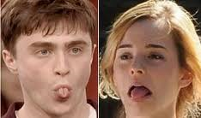
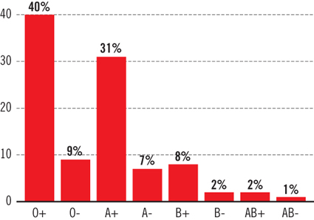
Human variation
Continuous
Discontinuous/discrete variation is
shown as a bar graph
Blood goups

Slide 27
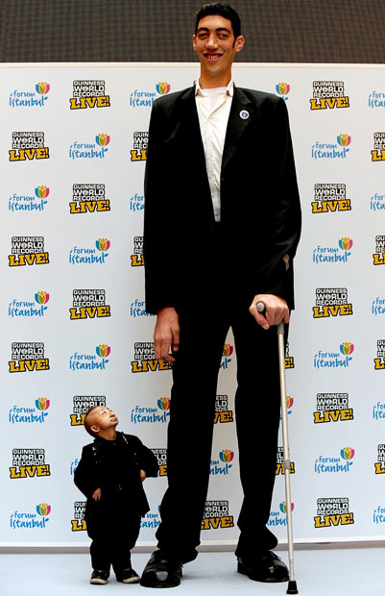
Normal distribution curve
In the population height is a continuous
Variation – continuous variation forms a
Normal distribution curve

Slide 28
Go to
http://www.bbc.co.uk/schools/ks3bitesize/science/organisms_behaviour_health/variation_classification/activity.shtml

Slide 29
Adaptations to environment

Slide 30
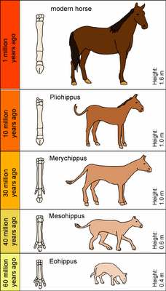
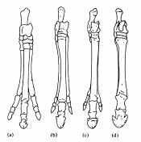
Evolution
Animals and plants produce too many offspring. Think about how many tadpoles you see at the start of spring, and how few frogs you see at the end of spring. A lot of them die, because there is not enough food to go around. Of course they all try their best to get all the food they need, so they have to compete with each other.

Slide 31
What is evolution
Animals and plants produce too many offspring. Think about how many tadpoles you see at the start of spring, and how few frogs you see at the end of spring. A lot of them die, because there is not enough food to go around. Of course they all try their best to get all the food they need, so they have to compete with each other.
Darwin realised all the members of a species are unique, they are all slightly different. Sometimes this can be the difference between life and death! Think about a bird which eats seeds which have a tough case like a nut. When nuts are in short supply only the really strong birds with big beaks will be able to crack them open and eat them. Since they get more food, they will be less likely to starve or get sick.
Now, since offspring inherit a lot of their characteristics from their parents birds with big beaks will have chicks that grow up to have big beaks too. So over many generations the average beak size in that group of birds which struggle to crack tough nuts will increase. Each generation changes by a really little bit, but all these changes can be added up over time to make a big difference: that’s evolution! Darwin called this process natural selection.

Slide 32
How do we know?
Fossils are the remains of animals and plants which died and were buried. Over millions of years they can be turned to rock. We have fossils of very simple life forms that date back to 3.5 billion years ago! That’s 3,500,000,000! As you go through the fossil record, towards the present day, more groups appear; plants, trees, flowers, animals, fish, amphibians, reptiles, mammals all pop up.
Another line of evidence to support evolution is DNA. Amazingly, you find some of the same chunks of DNA in bacteria as in humans. When you look at more closely related organisms you can see their DNA is increasingly similar. Famously the DNA sequences of humans and chimpanzees are about 97% identical.

Slide 33
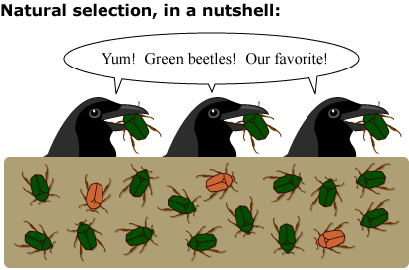
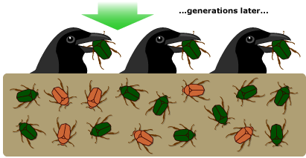
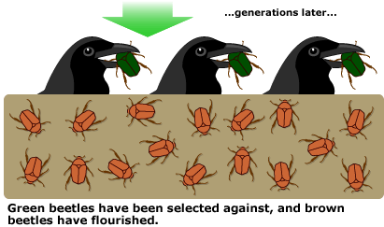
Natural selection

Slide 34
Remember
EXPLAIN means
What and why

Slide 35
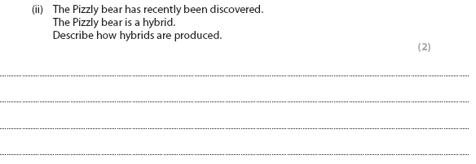
Remember – your explanation should contain scientific words and clear sentences.
Try not to use ‘it’ or ‘they’.

Slide 36
1.20 Describe the structure of the nucleus of the cell as containing chromosomes, on which genes are located
1.21 Demonstrate an understanding that genes exist in alternative forms called alleles which give rise to differences in inherited characteristics
1.22 Recall the meaning of, and use appropriately, the terms: dominant, recessive, homozygous, heterozygous, phenotype and genotype
1.23 Analyse and interpret patterns of monohybrid inheritance using a genetic diagram, Punnett squares and family pedigrees
1.24 Calculate and analyse outcomes (using probabilities, ratios and percentages) from monohybrid crosses
1.25 Describe the symptoms of the genetic disorders:
a sickle cell disease
b cystic fibrosis
1.26 Evaluate the outcomes of pedigree analysis when screening for genetic disorders:
a sickle cell disease
b cystic fibrosis

Slide 37
Genes

Slide 38
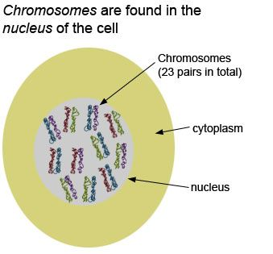
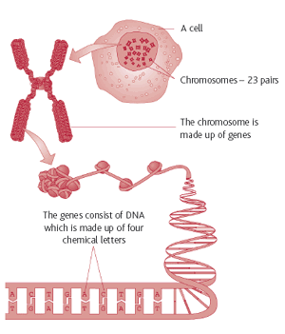
An animal cell

Slide 39
genes exist in alternative forms called alleles which give rise to differences in inherited characteristics
Definition: An allele is an alternative form of a gene (one member of a pair) that is located at a specific position on a specific chromosome. These DNA codings determine distinct traits that can be passed on from parents to offspring.

Slide 40
the meaning of, and use appropriately, the terms: dominant, recessive, homozygous, heterozygous, phenotype and genotype
Dominant – an allele that is seen (phenotype)
Recessive – only expressed (seen/phenotype) if there is no dominant allele
Homozygous – both alleles are the same (either both the dominant, or both recessive)
Hetrozygous – both alleles are different (a dominant and a recessive)
Phenotype – what you see/what is expressed
Genotype – the alleles on the chromosomes

Slide 41
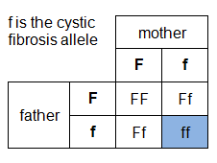
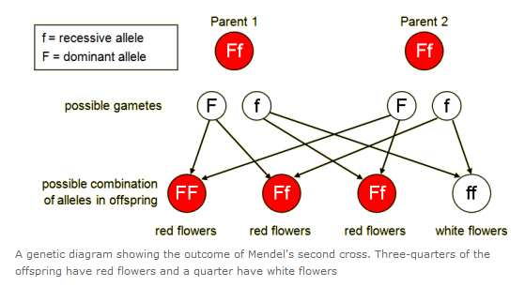
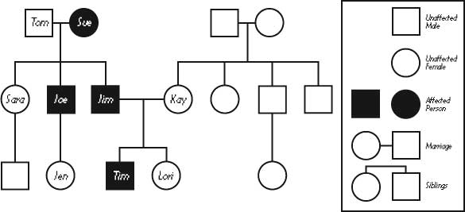
Analyse and interpret patterns of monohybrid inheritance using a genetic diagram, Punnett squares and family pedigrees

Slide 42
Describe the symptoms of the genetic disorders: a sickle cell disease b cystic fibrosis
Cystic fibrosis is a serious inherited disease which mainly affects the lungs and pancreas, but can involve other organs. Symptoms usually begin in early childhood and include persistent cough, wheeze, repeated chest infections, malabsorption of food, and general ill health. Treatments include antibiotics, physiotherapy, mucus thinning drugs, pancreatic enzyme replacements and other therapies.
Sickle Cell Disease Sickle cell disease is a group of inherited disorders in which deoxygenated red blood cells become distorted and take on a shape like a sickle. There are two common alleles for this gene. One causes normally shaped red blood cells and the other allele causes the red blood cells to have a sickle shape. The sickled cells can lodge in the smallest blood vessels and reduce the circulation of blood to tissues. The sickle cell allele is most common in areas where the disease malaria is a significant problem, and among people whose ancestors are from those areas. Evidence shows that having just one sickle cell allele makes a person resistant to malaria. The genetic condition is a recessive trait. When an indiviual has only one allele for the sickle cell trait, the person is a carrier.

Slide 43
1.26 Evaluate the outcomes of pedigree analysis when screening for genetic disorders: sickle cell disease
In the genetic pedigree, person U and her husband are considering having another child. What is the percent chance that this child will develop sickle cell disease?
25%
50%
75%
100%

Slide 44
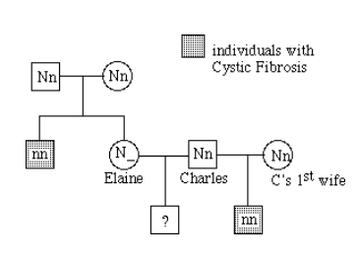
Imagine you are a genetic counselor, and a couple planning to start a family came to you for information. Charles was married once before, and he and his first wife had a child who has cystic fibrosis. The brother of his current wife Elaine died of cystic fibrosis. Cystic Fiborsis is a lethal recessive condition (a person with CF cannot have children).
What is the probability that Charles and Elaine will have a baby with cystic fibrosis? (Neither Charles nor Elaine has the disease)

Slide 45
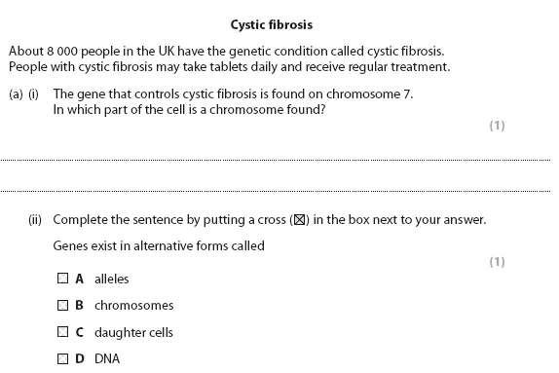

Slide 47
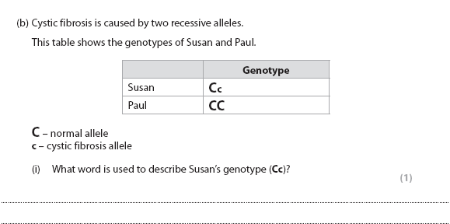

Slide 48
