Slide 1
Electrolysis

Slide 2
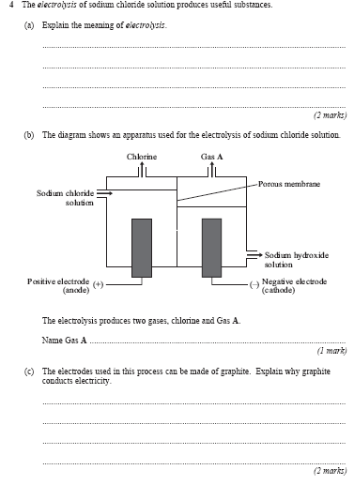
Starter

Slide 3
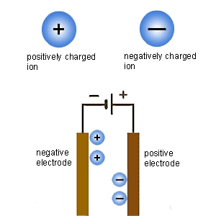
Electrolysis is the process by which ionic substances are decomposed (broken down) into simpler substances when an electric current is passed through them. It can only happen in an Ionic Solution which is dissolved in water or molten
Here is what happens during electrolysis:
-Positively charged ions move to the negative electrode during electrolysis. They receive electrons and are reduced.
-Negatively charged ions move to the positive electrode during electrolysis. They lose electrons and are oxidised.
Reduction:
Oxidation:

Slide 4
The extraction of copper from copper ore is done by reduction with carbon. However, the copper produced is not pure enough for use as a conductor, so it is purified using electrolysis.
Electrolysis of copper
In this process , the anode is made of the impure copper which is to be purified. The cathode is a bar of pure copper. The two electrodes are placed in a solution of copper(II) sulphate. Copper ions leave the anode and are attracted to the cathode, where they are deposited as copper atoms. The pure copper cathode increases greatly in size, while the anode dwindles away. The impurities left behind at the anode form a sludge beneath it.

Slide 5
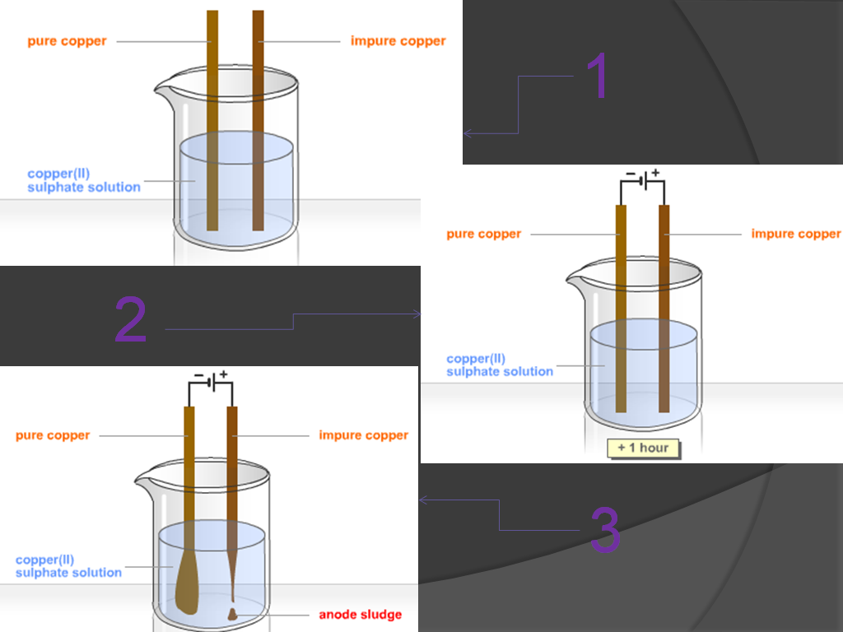

Slide 6
Hydrogen
making ammonia
making margarine
Chlorine
killing bacteria in drinking water
killing bacteria in swimming pools
making bleach
making disinfectants
making hydrochloric acid
making PVC
making CFC's - limited production
Sodium hydroxide
making soap
making paper
making ceramics
Brine is concentrated sodium chloride solution. If an electric current is passed through it, hydrogen gas forms at the negative electrode and chlorine gas forms at the positive electrode. A solution of sodium hydroxide forms.
You might have expected sodium metal to be deposited at the negative electrode. But sodium is too reactive for this to happen, so hydrogen is given off instead.

