Slide 1
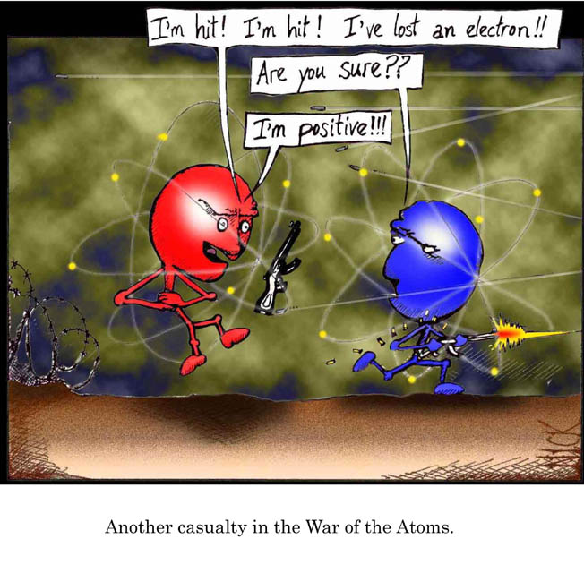
Ionic and metallic bonding!
Just to let you no: Delocalised electrons are the same as free electrons
http://www.bbc.co.uk/schools/gcsebitesize/science/add_aqa/atomic/ionicact.shtml

Slide 2
Metallic bonding
Delocalised Electrons are those which were extra on an atom. They don’t have a specific job and just float around. For example, If you were to be put into a foreign country you would be lost and walking around. Whereas in your hometown, you know where to go and what to do. These make metals good conductors of heat and electricity because of their free electrons.

Slide 3
The layers of atoms in metals are able to slide over each other. This means that metals can be bent or shaped.
Metals have a giant structure in which electrons in the highest energy level can be delocalised.
This produces a regular arrangement (lattice) of positive ions that are held together by electrons using electrostatic attraction.
These delocalised electrons can move around freely. This allows metals to conduct heat and electricity.

Slide 4
quiz
1. Ions usually have:
A full outer shell The same number of electrons as protons An odd number of electrons
2. What is the formula of the ionic compound formed by Al³⁺ and O²⁻?
Al₃O₂ Al₂O₃ AlO
3. Magnesium chloride has the formula MgCl₂. What are the ions in magnesium chloride?
Mg²⁺ and Cl⁻ Mg⁺ and Cl²⁻ Mg²⁻ and Cl⁺
4.Ionic compounds are held together by:
Electrostatic attraction between similarly charged ions Gravitational attraction between oppositely charged ions Electrostatic attraction between oppositely charged ions
5. Why do solid ionic compounds NOT conduct electricity?
There are no charged particles involved There are no electrons in ionic compounds The ions in a solid cannot move
Ions usually have a full outer shell.
The formula of the ionic compound formed by Al³⁺ and O²⁻ is Al₂O₃.
The ions in magnesium chloride are Mg²⁺ and Cl⁻
Ionic compounds are held together by electrostatic attraction between oppositely charged ions.
Solid ionic compounds do NOT conduct electricity because the ions in a solid cannot move

Slide 5
Thank you for watching by Lauren Whiting Lily Smith Rebecca thon

