Slide 1
Biology revision (B1)
Topic 1

Slide 2
Classification – remember 2 things about each group
There are millions of species on our planet. It would be difficult if we just tried to describe and name each one individually. Although species can be very different from each other, many of them have similar features that allow us to put them into groups.
multicellular | multicellular | Single and | Single cells | Single cells
photosynthesis | mobile | multicellular | Has a nucleus | No nucleus
 | Eat food

Slide 3
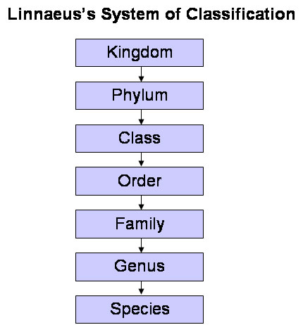
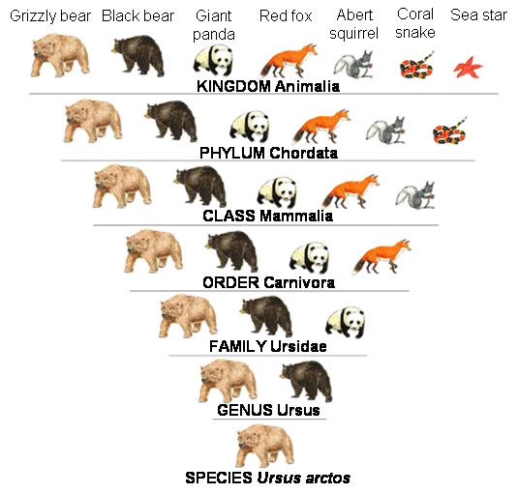
Classification – each kingdom is divided into Phylum – each phylum is divided into classes etc. a bit like you – first classification boy/girl, second – age/year group. Third – form group, fourth – last name, fifth – first name e.g. Smith, Jane. the last two classifications are like the last name and first name of the species their BINOMIAL name (Genus and Species) – e.g. Ursus arctos

Slide 4
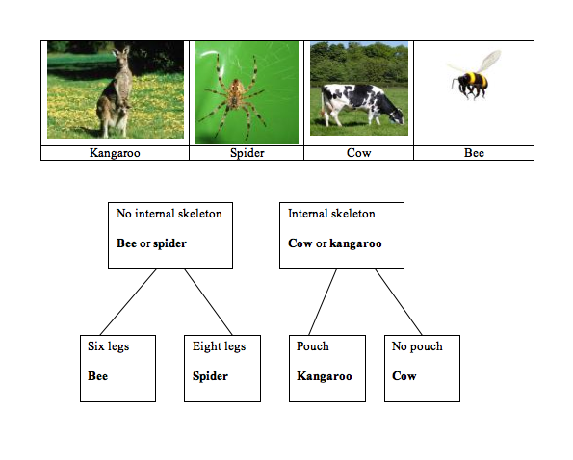
Invertebrates and vertebrates No back-bone backbone

Slide 5
Vertebrates and Invertebrates

Slide 6
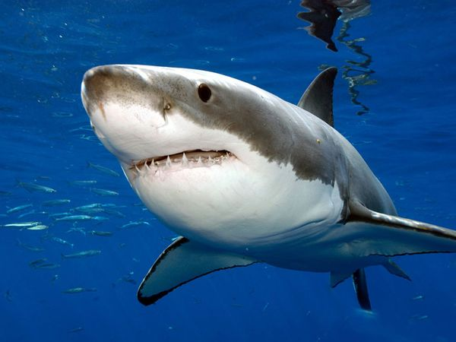
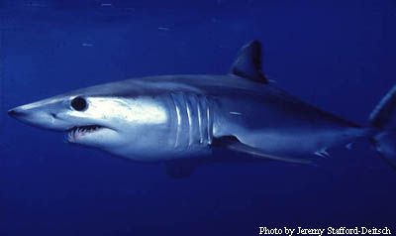
species
Species are the smallest groups. A species consists of all the animals of the same type, who are able to breed and produce young of the same kind. For example, while any two great white sharks are in the same species, as are any two makos sharks, great whites and makos sharks are different species (since they can't produce offspring together)
Great white shark
Makos shark

Slide 7
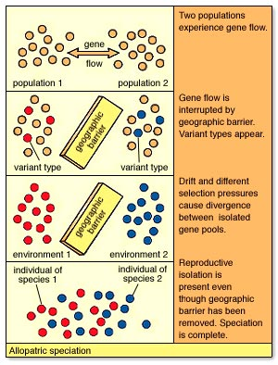
H - Geographic isolation + Speciation
All species change over time.
When a species is split, each group
will change in a different way because
their surroundings or food is different.
Eventually they will become so
different that they are different
species.

Slide 8
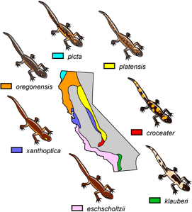
H paper - Ring species
Ring species are species with a geographic distribution that forms a ring. The many subspecies of salamanders in California exhibit subtle visible and genetic differences all along their range. They all interbreed with their immediate neighbours but not with others. Except the end groups who are too different to breed together
Eschscholtzii and klauberi

Slide 9
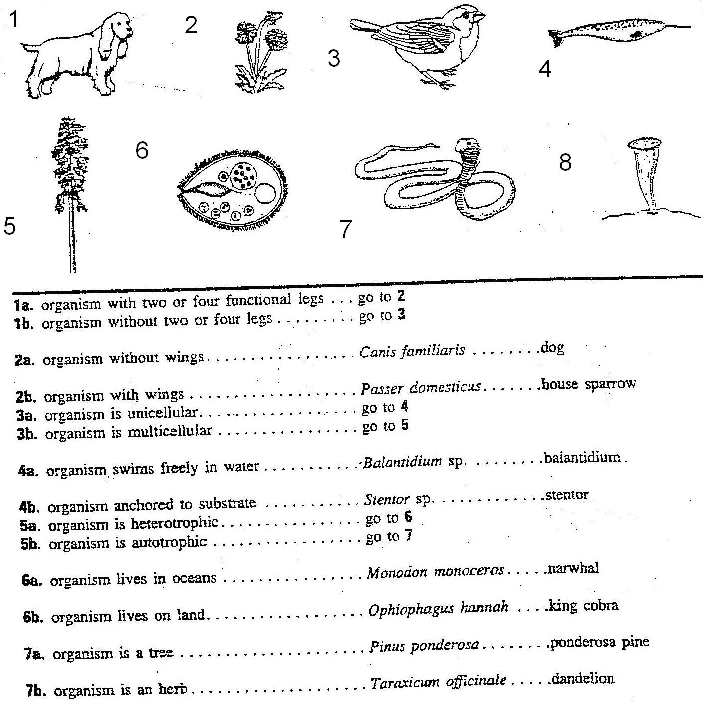
Variation - keys

Slide 10
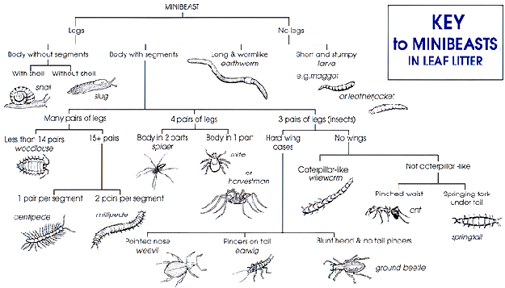
Variation - keys

Slide 11
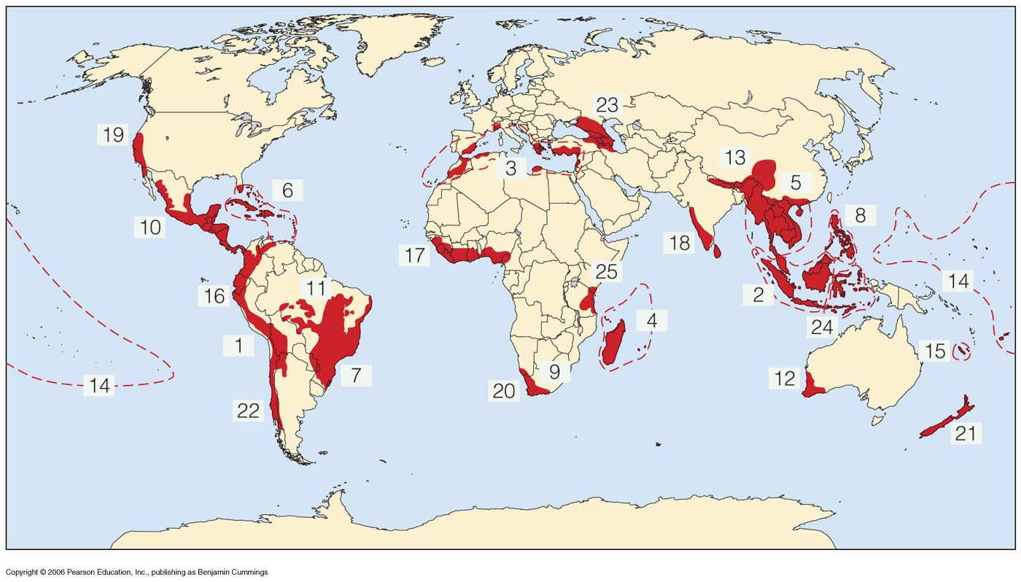
H paper - Biodiversity
A common measurement is species richness, or the number of species in an area. For example, a coral reef off the coast of Australia may be home to 500 species of fish, while only 100 species of fish might live off the rocky coasts of Japan.
This shows areas of the world that have high biodiversity
We get many
products from
living things
e.g. food and
medicine
The more species
there are the more
choice we have, now
and in the future

Slide 12
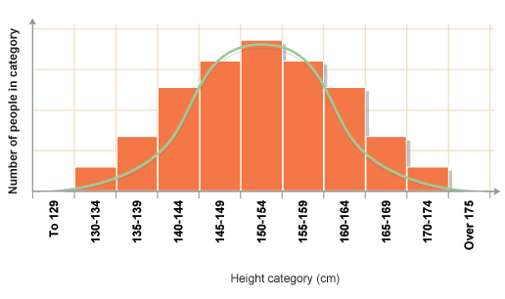
Variation
Height is a continuous variation and this type of graph is called a Normal Distribution

Slide 13
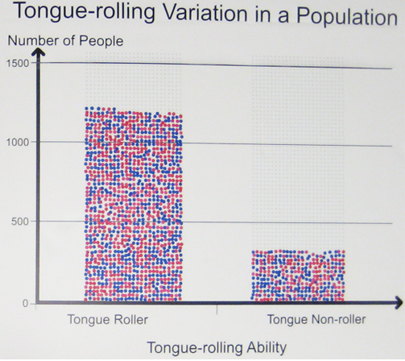
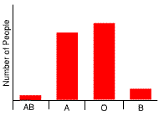
Variation -
Tongue rolling and blood groups are examples of discontinuous variation
These are displayed as bar charts

Slide 14
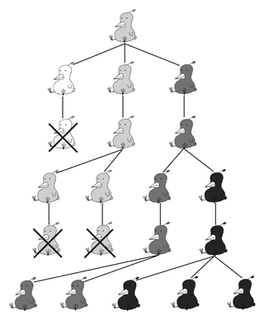
Evolution – by natural selection
All organisms have more offspring than can possibly survive - the ones that have variations that help them survive, live to pass on their genes to the next generation.

Slide 15
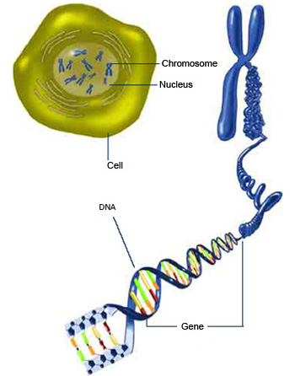
Gene
In every cell there is a nucleus
The nucleus contains a full set
of chromosomes
Chromosomes are stacks of genes
Genes are units of information
e.g. you will have freckles
Genes are made up of DNA

Slide 16
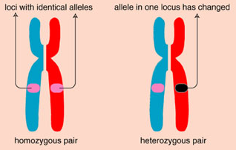
Alleles

Slide 17
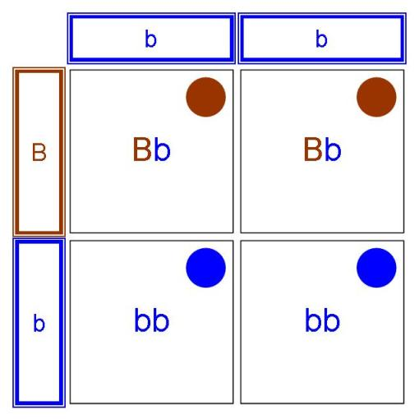
Punnett Squares
BB – Homozygous Dominant
Bb – hertozygous
Bb – homozygous recessive
Probability
Brown eyes 1:1
Percentage
Brown eyes
2/4 x 100 = 50%

Slide 18
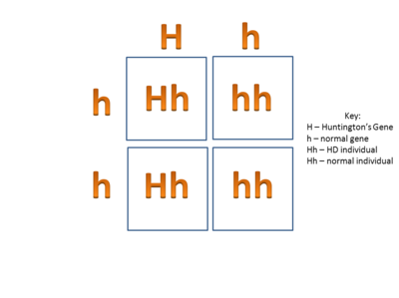
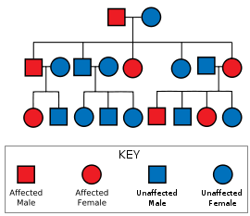
Genetic disorders – dominant Huntingtons
Description: Huntington’s disease is a brain disorder
that affects thinking, talking, and moving.
It destroys cells in brain, which controls movement, emotion, and cognitive ability.

Slide 19
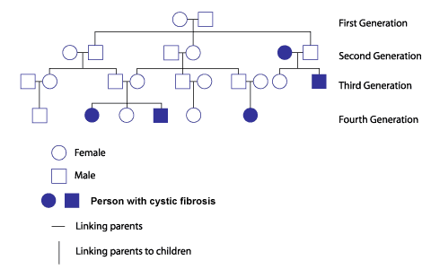
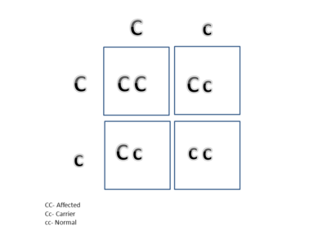
Genetic disorders - recessive
Cystic Fibrosis is a recessive disorder. To inherit the disorder both parents must have the bad gene. If the child only gets one bad gene from a carrier parent, the child will be a carrier also. If the child of two carrier parents and get both bad genes, the child will be affected. If the child gets two normal genes, the child will be normal

Slide 20
Homeostasis – key words
Internal environment
Sweat gland
Urine
Kidneys
Osmoregulation
Glucose regulation
Hypothalamus
Dermis
Erector muscles
Sebaceous glands
Vasoconstriction (H)
Vasodilation (H)
Negative feedback (H)
Inside your body
Cool the body
Contains waste from the kidneys
Cleans the blood
Kidneys regulate the waste in the blood
Sugar regulation in the blood
Part of the brain that regulates the body
Part of the skin
Muscles that make hair stand on end
Gives out oils to keep air subtle
Blood vessels get narrow
Blood vessels get wider

Slide 21
Homeostasis

