Slide 1
Edexcel Physics P2 (2012/3)

Slide 2
Topic 3
Vectors and velocity
Acceleration
Velocity time graphs
Forces
Resultant forces
Forces and acceleration
Terminal velocity

Slide 3
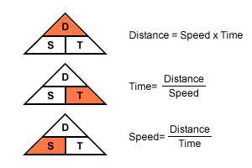
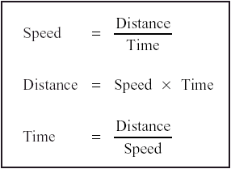
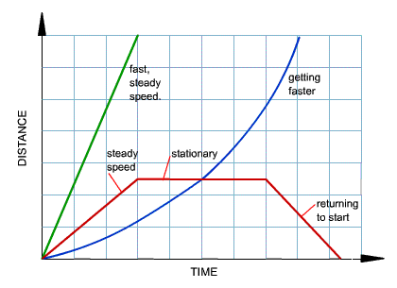
Speed (m/s) = distance (m) / time (s)
Speed is the rate of change of distance with time. The gradient (slope) of the graph gives us speed. The gradient is given by the change in distance (rise) ÷ time taken (distance along y-axis).
If the gradient is steeper, the speed is greater. If the graph is curved, it means that the speed of the object is changing. The gradient of the graph tells us how the speed is changing.

Slide 4
Speed Questions – show working and units
Question 1
Jane drives at an average speed of 45 mph on a journey of 135 miles. How long does the journey take? Question 2
Chris cycles at an average speed of 8 mph. If he cycles for 6½ hours, how far does he travel? Question 3
Nikki has to travel a total of 351 miles. She travels the first 216 miles in 4 hours. (a) What is her average speed for the first part of the journey? Her average speed is the same for the whole of her journey. (b) How long does the whole journey take?
135 miles ÷ 45 mph = 3 hours
8 mph × 6.5 hours = 52 miles
216 miles ÷ 4 hours = 54 mph
351 miles ÷ 54 mph = 6.5 hours

Slide 5
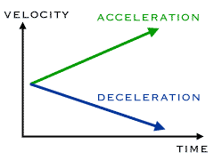
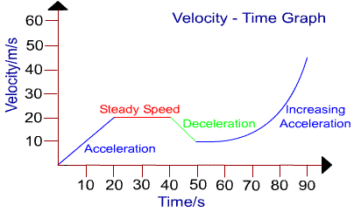
Velocity (m/s)
When velocity is changing, the word acceleration is used. Acceleration is also a vector.
The sloped line ( / ) on the graph is called the gradient, it represents the acceleration.
To work out the gradient (acceleration) in the first part of the graph:
We take the vertical reading from the graph where the acceleration finishes and divide it by the horizontal reading where the acceleration finishes.
vertical / horizontal = 20 / 20 = 1m/s²

Slide 6
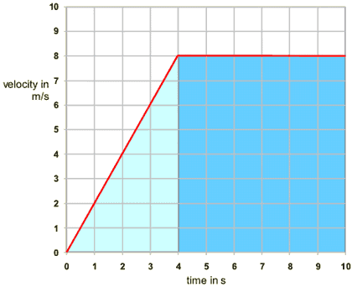
Velocity – the area under the graph is the distance travelled
The area under the line in a velocity-time graph represents the distance travelled. To find the distance travelled in the graph above, we need to find the area of the light-blue triangle and the dark-blue rectangle.
Area of light-blue triangle
The width of the triangle is 4 seconds and the height is 8 metres per second. To find the area, you use the equation: area of triangle = ¹⁄₂ × base × height
so the area of the light-blue triangle is ¹⁄₂ × 8 × 4 = 16m.
Area of dark-blue rectangle
The width of the rectangle is 6 seconds and the height is 8 metres per second. So the area is 8 × 6 = 48m.
Area under the whole graph
The area of the light-blue triangle plus the area of the dark-blue rectangle is:
16 + 48 = 64m. This is the total area under the distance-time graph. This area represents the distance covered.

Slide 7
Acceleration (m/s²)
In 5 seconds
Acceleration = from 15 to 32 m/s = 17 m/s (this is the change in velocity)
5 s
= 3.4 m/s²

Slide 8
Acceleration practice questions
QUESTION: If a car accelerates from 5 m/s to 15 m/s in 2 seconds, what is the car's average acceleration? Show calculation and unit.
5 m/s2
QUESTION: How long does it take to accelerate an object from rest to 10 m/s if the acceleration was 2 m/s²? Show calculation and unit.
5 s
QUESTION: Carl started to run at 10 km/h when he left his house. He arrived at school 30 minutes later. How fast was he running when he arrived there? Assume that his average acceleration was 30 km/h². show calculation and unit.
25 m/s

Slide 9
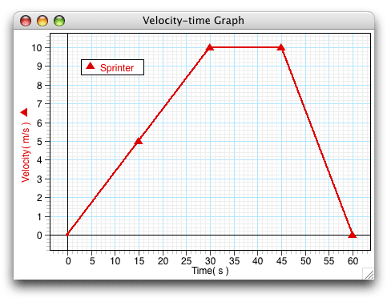
Acceleration (m/s²)
Calculate the acceleration at:
15 s
35 s
55 s
At those times is the acceleration
Constant, increasing or decreasing
How long is the sprinter running at
a constant velocity
Answers
15 s 5/15 = 0.3 m/s2 accelerating
35 s 10/35=0.29 m/s2 constant
55 s 3/55 = 0.5 m/s2 decelerating
At those times is the acceleration

Slide 10
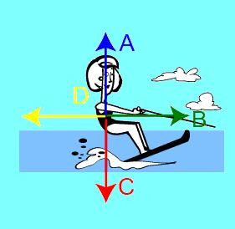
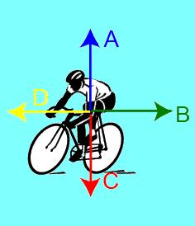
Forces
Force arrows are usually drawn from the centre
They are in the direction of the force
The length of the arrow represents the size
That means if 2 forces are equal and opposite, the arrows
will be pointing in opposite directions and be of
equal length.
An upward force is often called ‘up-thrust’, ‘lift’ or ‘air resistance’
A forward force is often called ‘thrust’
A downward force is often called ‘gravity’ or ‘weight’
A backwards force is often called ‘air resistance’ or ‘friction’
Questions
On the cyclist, which arrow shows:
The force of gravity, or weight
The combined forces of friction
The thrust provided by the cyclist
Answers
C, B, D

Slide 11
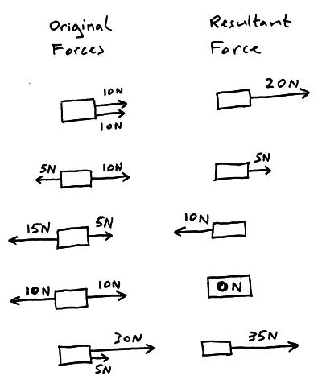
Resultant Forces
A resultant force is the ‘result’ of
Adding or subtracting the original forces
You add if they are in the same direction
You subtract is they are in opposite directions
If the resultant force is zero, then the object is
either stationary or is moving at a constant speed
If the resultant force is NOT zero then the object is
either speeding up or slowing down

Slide 12
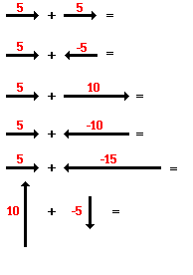
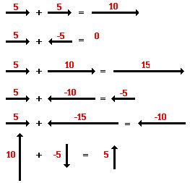
Resultant forces - questions
Draw the line and the answer
Answers

Slide 13
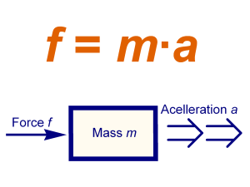
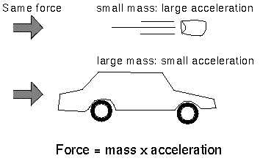
Forces and acceleration

Slide 14
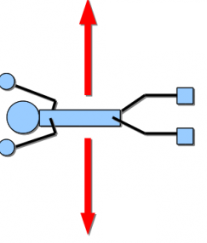
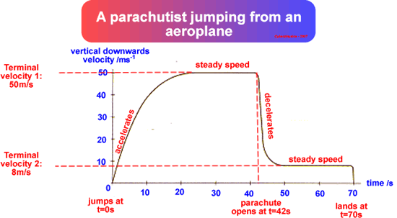
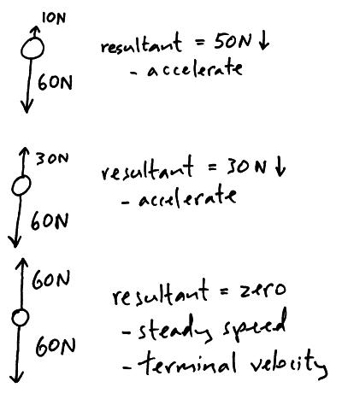
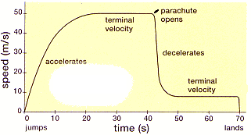
Terminal Velocity (m/s)
When an object’s weight is balanced by the air resistance. There is no resultant force and the object reaches a steady speed, called the terminal velocity.

Slide 15
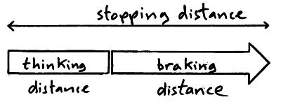
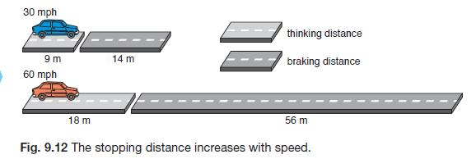
Stopping distances
Thinking distance
How far the car
travels from when
the driver sees she
needs to stop to
when she puts her
foot on the brake
Things that can
increase this
distance:
(They only affect
The driver)
distractions
mobile phone use
alcohol, drugs
tiredness
These make thinking distance longer
and also stopping distance longer
(but not braking distance)
Breaking distance
How far the car
travels from
when the
driver puts her
foot on the brake
to when the car
actually stops
Things that make
Braking distance
Longer – they only
Affect the car
Worn tyres
Icy/wet roads
Worn brakes
These will make braking distance and stopping distance longer, but not thinking distance

Slide 16
Stopping distance
Name 3 factors that affect a drivers reaction time
What effect does an increase in thinking time have on
A) thinking distance
B) braking distance
C) stopping distance
If a car goes faster what effect will this have on
A) thinking time
B) braking distance
C) stopping distance
D) stopping time
What effect will worn tires have on
Thinking time
Braking time

Slide 17
Stopping distance - Answers
Name 3 factors that affect a drivers reaction time
What effect does an increase in thinking time have on
A) thinking distance
increases
B) braking distance
No effect
C) stopping distance
increases
If a car goes faster what effect will this have on
A) thinking time
No effect
B) braking distance
increases
C) stopping distance
increases
D) stopping time
No effect
What effect will worn tires have on
Thinking time
No effect
Braking time
increases

