Slide 1
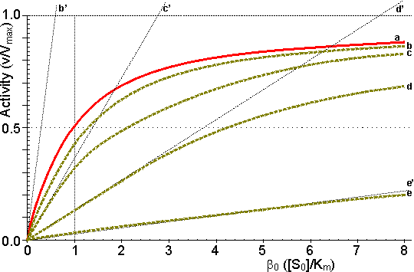
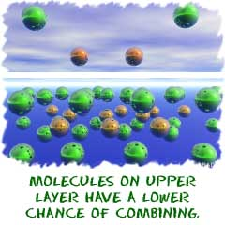
Rates of Reaction
By Lenina, Vicky and Jade

Slide 2
Starter…….
Rates of reaction crossword……

Slide 3
The rates of reaction is the speed at which a reaction happens.
If a reaction has a low rate, that the molecules combine at a slower speed than a reaction with a high rate.
Some reactions take hundreds, maybe even thousands of years while others can happen in less than one second.
The rate of reaction depends on the type of molecules that are combining

Slide 4
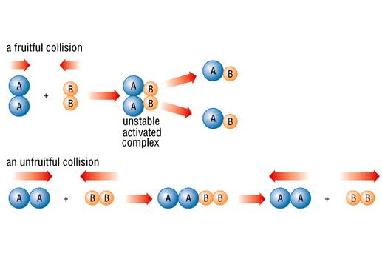
There is another big idea for rates of reaction called collision theory. The collision theory says that the more collisions in a system, the more likely combinations of molecules will happen.
If there are a higher number of collisions in a system, more combinations of molecules will occur.
The reaction will go faster, and the rate of that reaction will be higher.

Slide 5
Collision theory
Higher temperature increases the rate of reaction. When the temperature is increased the particles all move quicker. If they’re moving quicker, they’re going to have more collisions.
Higher concentration (pressure) increases collisions. If a solution is made more concentrated it means there are more particles of reactant knocking about between the water molecules which makes collisions between the important particles more likely. In a gas, increasing the pressure means the particles are more squashed up together so there are going to be more collisions.

Slide 6
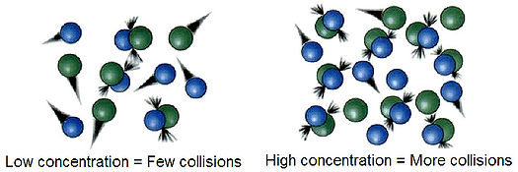
Larger surface area increases collisions. If one of the reactants is a solid then breaking it up into smaller pieces will increase its surface area. This means the particles around it in the solution will have more area to work on, so there’ll be more useful collisions.
Catalysts increase the number of successful collisions. A solid catalyst works by giving the reacting particles a surface to stick to. They increase the number of successful collisions by lowering the activation energy

Slide 7
Now you can watch a video on everything so far…….
http://www.bbc.co.uk/schools/gcsebitesize/science/add_aqa/chemreac/rates.shtml

