Slide 1
Using Ions in solution

Slide 2
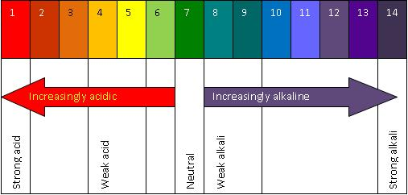
Acids and Alkalis
1. Where would vinegar come on the Ph scale?
2. Where would normal rain come on the Ph scale?
4. Where would Washing up liquid come?
5. Where would pure water come?
3. Where would Bleach come?

Slide 3
Acids and Bases neutralise each other
An acid is a substance with a Ph less than 7.
A Base is an alkali that has a Ph more than 7 and dissolves in water.
The reaction between acids and bases is called neutralisation
When an acid neutralises a base (or vice versa), the products are neutral
Acid + base Salt + Water

Slide 4
Acids Reacting with Metals
Acids + Metal Salt + Hydrogen
The more reactive the metal the faster the reaction will go.
The speed of the reaction is indicated by the rate at which the bubbles of hydrogen are given off.
How do you test for hydrogen?
The name of the salt produced depends on which metal and acid is used……

Slide 5
Hydrochloric Acid will always produce Chloride salts…
Magnesium
2HCL + Mg MgCl₂ + H₂ (…………………….Chloride)
6HCl + 2Al 2AlCl₂ + 3H₂ (…………………….Chloride)
2HCl + Zn ZnCl₂ + H₂ (…………………….Chloride)
Aluminium
Zinc
Sulfuric Acid will always Produce Sulfate salts…
H₂SO₄ + Mg MgSO₄ + H₂ (…………………….Sulfate)
3H₂SO₄ + 2Al Al₂(SO₄)₃ + 3H₂ (…………………….Sulfate)
H₂SO₄ + Zn ZnSO₄ + H₂ (…………………….Sulfate)
Magnesium
Aluminium
Zinc

Slide 6
Oxides, Hydroxides and Ammonia
Acid + Metal Oxide Salt + Water
Acid + Metal Hydroxide Salt + Water
Some metal oxides and metal hydroxides dissolve in water.
These soluble compounds are alkalis.
Even bases wont dissolve in water will still react with acids.
So, all metal oxides and metal hydroxides react with acids to form a salt and water

Slide 7
Making Salts
Making soluble salts from insoluble bases:
To make a soluble salt you must pick the right acid along with metal carbonate or metal hydroxide, as long as it’s insoluble ( the reason you cannot use a soluble base is because you won’t be able to tell when the reaction has finished)
E.G. Copper Carbonate + Nitric Acid Copper Nitrate
Making insoluble salts – Precipitation Reactions
If the salt you want to make is insoluble, you must use a precipitation reaction. For this you must use an acid and a nitrate and mix them together. Once the salt is left at the bottom(precipitated) filter the solution wash it and dry it on filter paper.
E.G. Hydrochloric acid + Lead Nitrate Lead Chloride

Slide 8
Making Salts by displacement
When you put a more reactive metal (e.g. Magnesium) into a salt solution of a less reactive metal (e.g. Copper Sulfate) the magnesium will take the place of the Copper making it magnesium sulfate.
The displaced metal then coats itself onto the more reactive metal
One the magnesium has been coated with copper the reaction stops... This isn’t the most practical way to make salts however
Activity: http://www.bbc.co.uk/schools/gcsebitesize/science/add_aqa/ions/acidsbasesact.shtml

