Slide 1
Core Chemistry Revision
To improve understanding of key topics

Slide 2
The Early Atmosphere
What were the 2 main gases in the early atmosphere?
Where did these gases come from?
Why did the carbon dioxide level decrease?

Slide 3
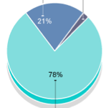
The Modern Atmosphere
Name the gases and the percentages:

Slide 4
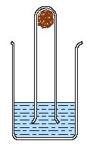
Oxidation
Oxidation – this is a reaction where things react and form compounds with ____________.
We can tell _________ is around in the air because it reacts with most metals (for example, iron reacts with ______ to form rust)

Slide 5
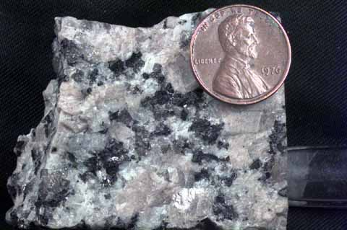
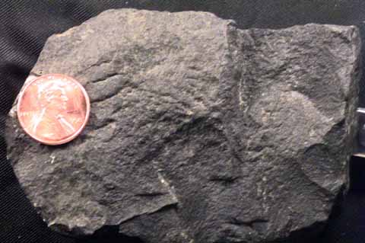
Rocks
Igneous rock –
Sedimentary rock –
Metamorphic rock -

Slide 6
Limestone
What do we use it for:
G________
C_________
C_________
Quarrying:
Advantages:
Disadvantages:

Slide 7
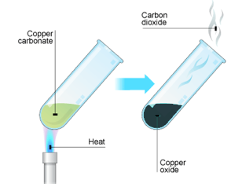
Thermal Decomposition
Heating to break down a compound.
How could you test if one metal carbonate was more stable (stronger) than another carbonate?

Slide 8
Calcium Compounds – all neutralise acids
Calcium Carbonate –CaCO3
Calcium oxide - CaO
Calcium hydroxide - Ca(OH)₂

Slide 9
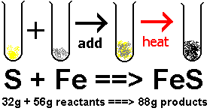
Conservation of matter

Slide 10
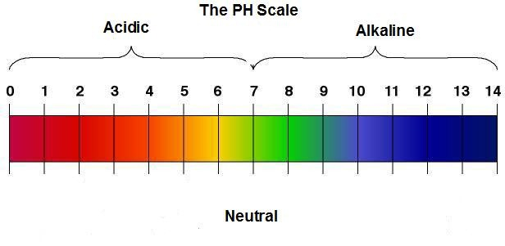
Acids and neutralisation
Acidity is measured in - _____
You can measure pH using _________.
______ and ____ neutralise acids.
Indigestion tablets __________ acid in the stomach. The more acid they neutralise the _________ the tablet.

Slide 11
Hazard Symbols
___________
___________
___________
___________

Slide 12
Electrolysis – splitting compounds using electricity
Water (H2O) can be split into: _________ and _______
Hydrochloric acid (HCl) can be split into:
____________ and ___________

Slide 13
5 minute break
Gives your brain a chance to process what you have just learned.
Chance to ask me any other questions.
Individual revision

Slide 14
Chemical Tests
For hydrogen –
For oxygen –
For chlorine -

Slide 15
Chlorine
Is it harmful?
What does it keep clean?
What plastic is it found in?

Slide 16
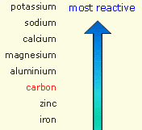
Metal ores
Ores are _______________________________
Extracting metals from ores
_________________ ___________________

Slide 17
Oxidation and Reduction
Oxidation is when a compound gains ___________
Reduction is when a compound loses __________

Slide 18
Why recycle anything?
1) It saves ___________.
2) It saves _______ ____________.
3) It means less waste is sent to ____________.
HOWEVER, waste products must be ___________
AND some ________ is still needed to melt and re-use

Slide 19
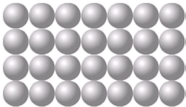
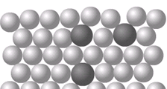
Properties of metals and alloys
Metals:
____________
____________
____________
____________
Alloys:
You add another element (with different sized atoms)
Stops the _____ of atoms _____ over each other

Slide 20
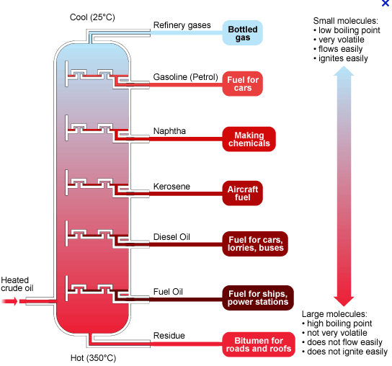
Crude Oil – mixture of hydrocarbons
Hydrocarbons only contain hydrogen and carbon atoms.

Slide 21
Combustion
HC + oxygen → carbon dioxide + water
CH₄ + __O₂ → CO₂ + __H₂O

Slide 22
Incomplete Combustion
INCOMPLETE – usually means BAD
HC + (not much) oxygen → soot + carbon monoxide
Soot is bad for _________ & Carbon monoxide is __________

Slide 23
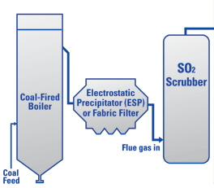
Acid Rain
When coal is burned in power stations, often ________ ______ is released.
This gas then reacts with ________ in the atmosphere to produce acid rain.
We can reduce acid rain by scrubbing the waste gases with calcium oxide and water. This neutralises the sulfur dioxide.

Slide 24
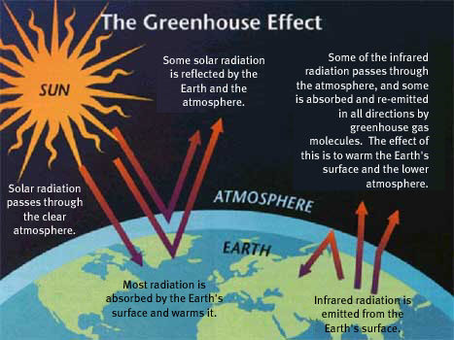
Climate Change
Explain the greenhouse effect in 4 simple steps:
1)
2)
3)
4)

Slide 25
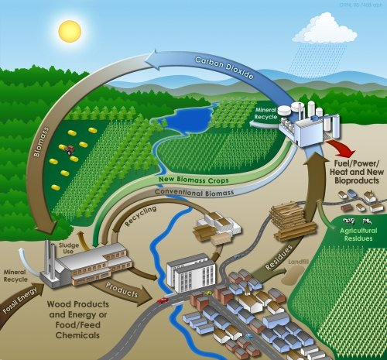
Biofuels
Advantages:
Disadvantages:

Slide 26
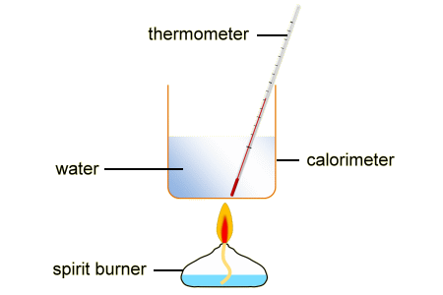
Choosing a fuel
How could you test what fuel produces the most energy?
What makes a ‘bad’ fuel:
_______________
_______________
_______________
Fuel 1
Fuel 2

Slide 27
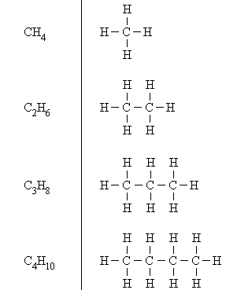
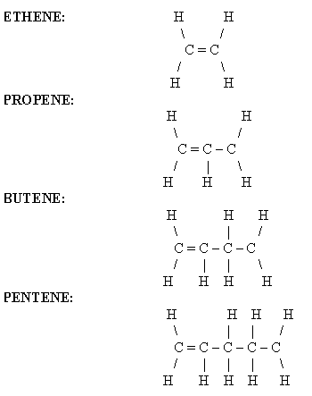
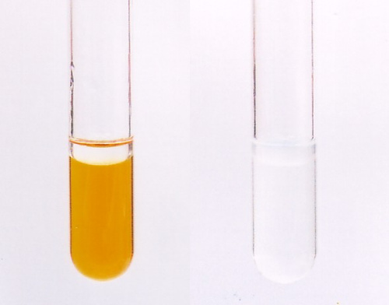
Alkanes and Alkenes
____________ bonds
saturated hydrocarbon
One _________ bond
unsaturated hydrocarbon
What is the test for alkenes and alkanes?

Slide 28
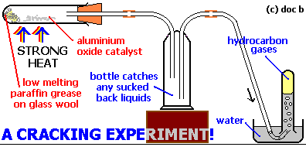
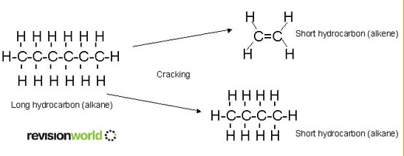
Cracking
Describe what cracking is: ___________________________
What is the point of cracking: ________________________________

Slide 29
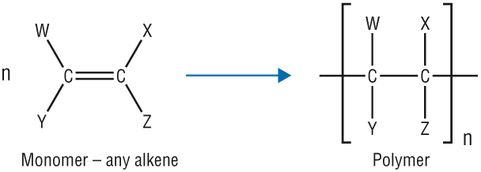
Polymerisation
What is polymerisation? ____________________________________
What sort of hydrocarbon do you need for polymerisation? __________
What are the rules for drawing a polymer from a monomer?

Slide 30
Disposing of polymers
Landfill
Recycling
Incineration

Slide 31
That’s it!

