Slide 2
The solar system
Describe the geocentric and heliocentric models of the solar system
Why do we accept the heliocentric model?
Describe in detail the structure of the solar system (planets, belts, clouds)!

Slide 3
Observing the universe
What are the 3 main ways to observe the universe?
What is the advantage of each?
How do we look for life on other planets?

Slide 4
Reflection and refraction
At boundaries of different materials waves change how they behave. All waves will bounce off a shiny surface. This is called __________.
All waves change direction at the boundary with a different material. This is called __________. Waves change direction because of the change in ___________ of the materials. As a wave travels from a low density material such as air, to a high density material such as glass, it _____________.

Slide 5
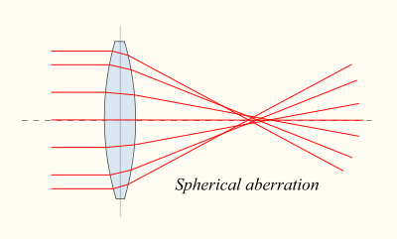
Lenses
What type of lens is this?
How do you measure focal length?
How can you change focal length?
F = Focal point
Focal length

Slide 6
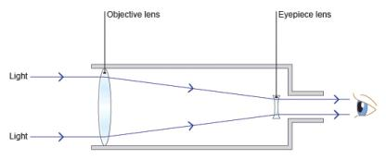
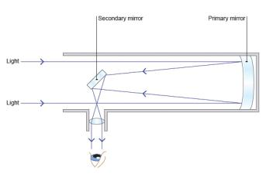
Telescopes
What are the two types?
What is the objective lens in each? What does it do?
What is the eyepiece in each? What does it do?
Similarities:
Differences:

Slide 7
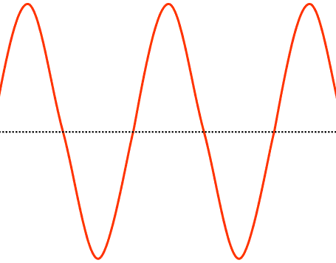
Waves
All waves transfer _________ and information but do not transfer __________.
Describe, with unit
amplitude
wavelength
Frequency
What are the two main types of waves, describe and give examples
What are the two ways to calculate speed?

Slide 8
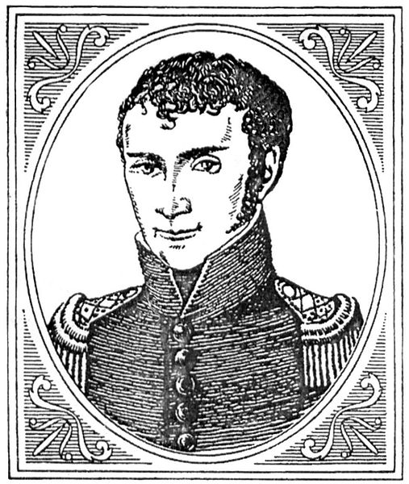
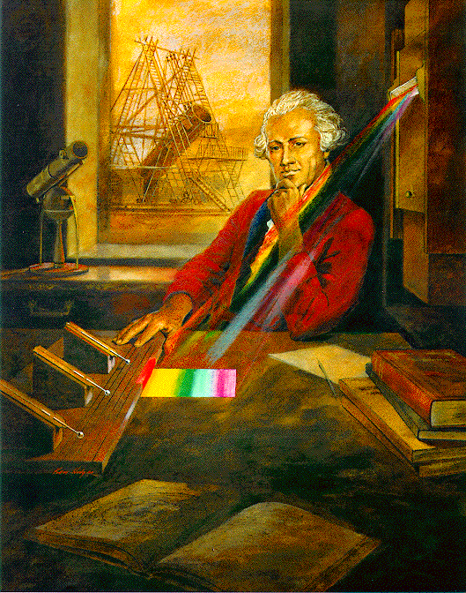
Electromagnetic spectrum
Label the EM spectrum and describe each ‘end’ in terms of frequency and wavelength. Include the colour spectrum of visible light.
Explain how Herschel and Ritter made their discoveries

Slide 9
EM – Uses and Dangers
What are the uses of each part of the EM spectrum?
What are the dangers of each part of the EM spectrum?
How are gamma rays used to both detect and treat cancer?
What is ionising radiation? Give examples

Slide 10
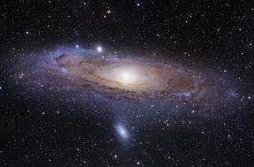
The universe
Our sun is a ______. It is stable which means two forces: _________ and __________ are balanced.
A collection of stars is called a ___________.
Everything - all matter and energy is known as ____________.

Slide 11
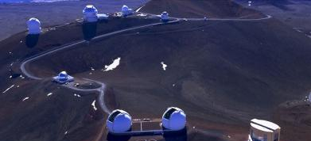
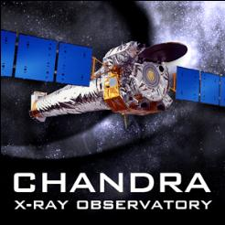
Telescopes (again)
Modern telescopes have helped our observations of galaxies through increased magnification, found objects not detectable using visible light and allowed us to collect and store more data.
Why are telescopes on earth placed in remote hilly locations?
Why are some telescopes placed in space?
Why are spectrometers useful?

Slide 12
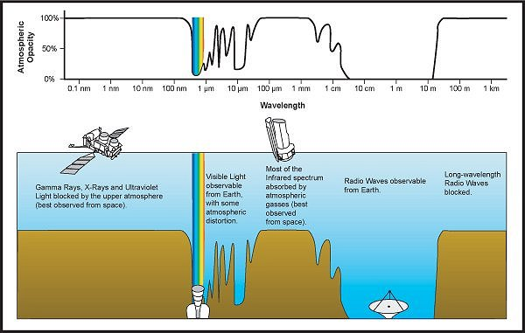

Slide 13
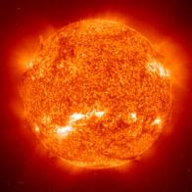
Stars
What is the life cycle of an averages sized star like our sun?
How is the life cycle of a massive star different?
What is the role of gravity?

Slide 14
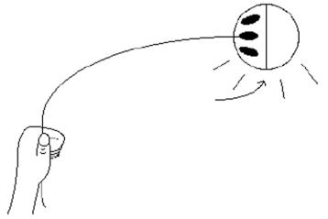
Theories of the universe
What happens to waves as they are moving towards us? Away from us?
Explain the evidence for an expanding universe
Why is the Big Bang theory accepted instead of the Steady State theory?

Slide 15
5 minute break
Gives your brain a chance to process what you have just learned.
Chance to ask me any other questions.
Individual revision

Slide 16
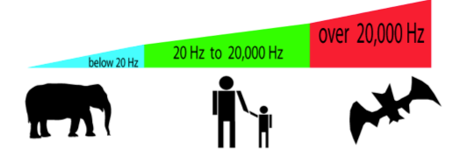
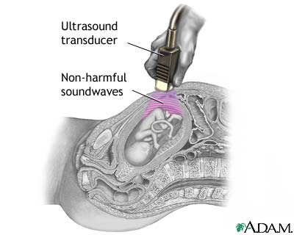
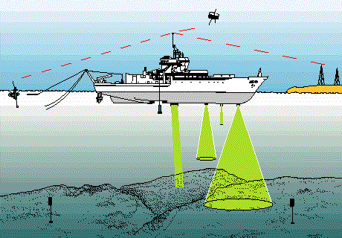
Infrasound and Ultrasound
Where are ultrasound and infrasound on this diagram?
Ultrasound can be used for:
________________
________________

Slide 17
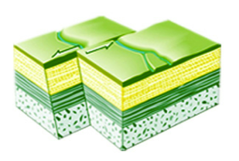
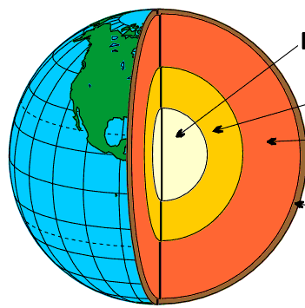
Earthquakes
What causes earthquakes?
What are the four main layers of the Earth?
_______________
_______________
_______________
_______________

Slide 18
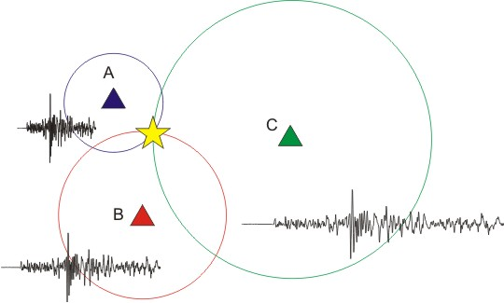
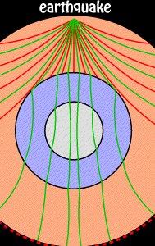
Detecting earthquakes
A __________ is a machine that can be used to detect earthquakes.
Earthquakes generate __ waves and __ waves.
Which wave is transverse and which is longitudinal?

Slide 19
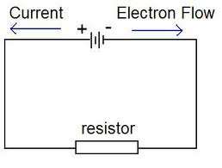
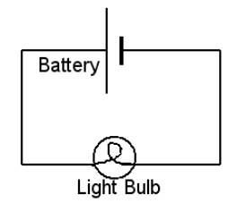
Current and circuits
Current is measured using an ________ and is caused by electrons moving around a circuit.
On this diagram, which way are the electrons moving?
In which direction is conventional current moving?

Slide 20
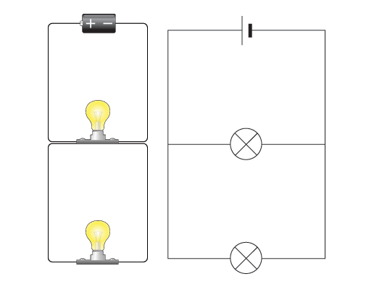
Voltage (potential difference)
The voltage is the push of the circuit (imagine a pump). It is measured using a ___________.
In a parallel circuit, the
voltage is ________ for each
loop (branch)
3V
3V
3V

Slide 21
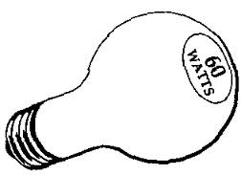
Electrical Power (watts)
P = I x V
Where P = _________
I = _________
V = _________

Slide 22
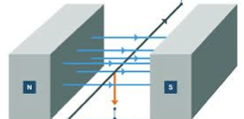
Generating Current
To generate electrical current you need:
____________
____________
Direct current is when electricity flows in ____ direction.
Alternating current is when current flows in ______ directions.

Slide 23
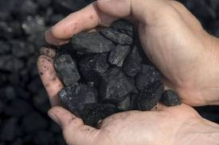
Renewable Energy
3 examples of non-renewable energy are:
________________, ______________, _________________
Burning hydrocarbons causes CO2 to be released, leading to an increased _________ _________.
Non-renewable fuels will all eventually ______ _______.
Nuclear waste is _______ to dispose of safely.

Slide 24
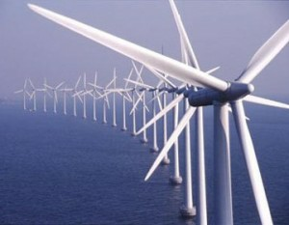
Renewable energy sources
3 type of renewable energy are:
____________, ________________, _______________
Can you list the advantages and disadvantages of each.
_____________________ _____________________
_____________________ _____________________
_____________________ _____________________

Slide 25
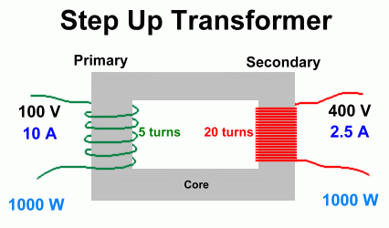
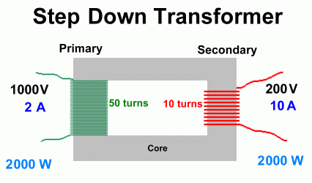
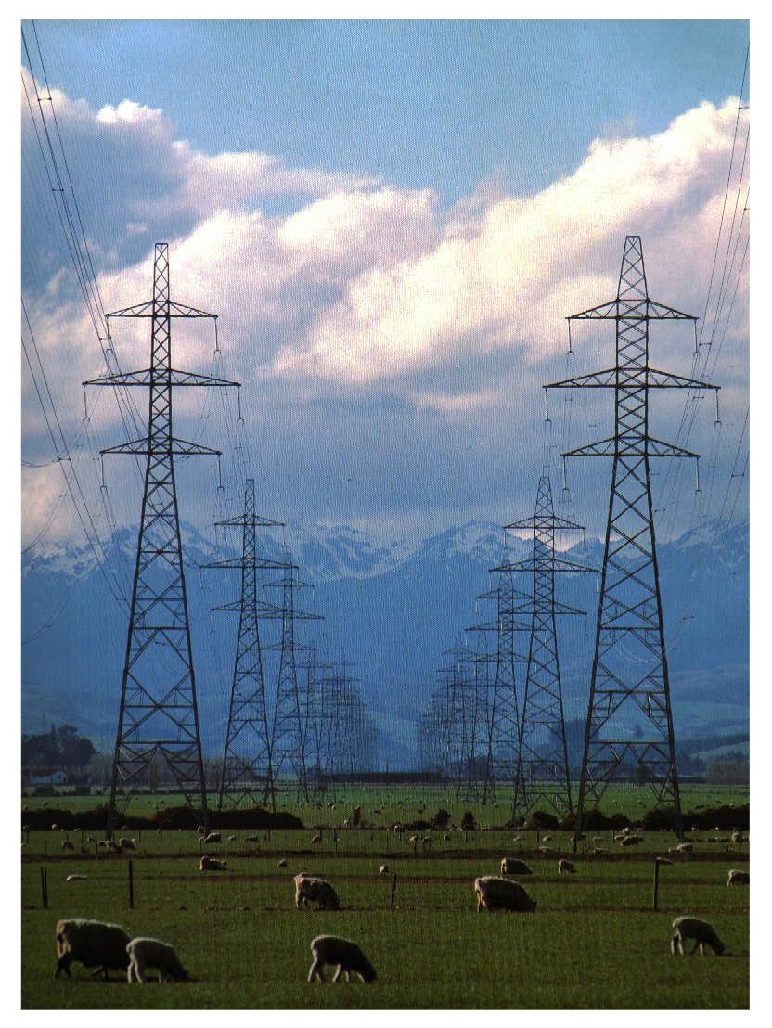
Transformers
A transformer allows you to change the ______ between 2 circuits.
Increasing the _______ means less electrical energy is lost as heat (when carried between pylons in the National Grid).

Slide 26
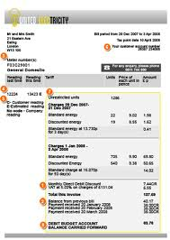
Kilowatt Hours (kW h)
Is how you measure how much electricity in your home.
How could you reduce your bill:
_____________________________
_____________________________
_____________________________

Slide 27
Energy Changes – describe each energy transfer
Burning coal = ____________→ ______________
Light bulb = _____________ → _______________
Car speaker = ____________→ ______________
Sky diver = ____________→ ______________
Car crash = ____________→ ______________

Slide 28
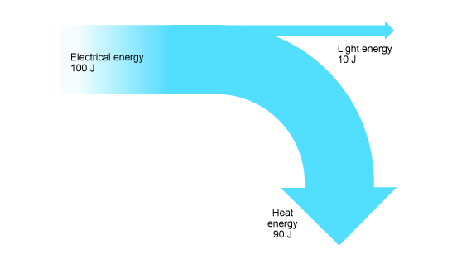
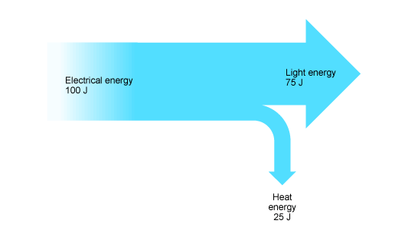
Efficiency
Which light bulb is more efficient?
Useful energy x 100 = efficiency
Total energy

Slide 29
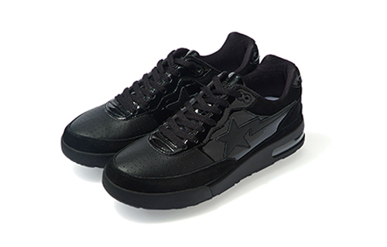
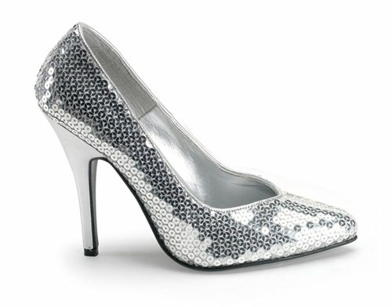
Radiated and absorbed heat energy
Which is the best absorber?
Which is the best emitter?
Which is the best reflector?

Slide 30
That’s it!

